Slide 1
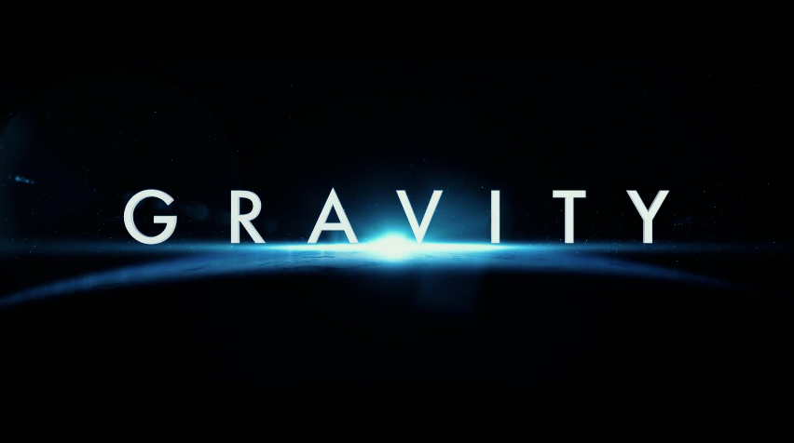
GRAVITY
By: Ali K, Riley T, and Shant A.

Slide 2
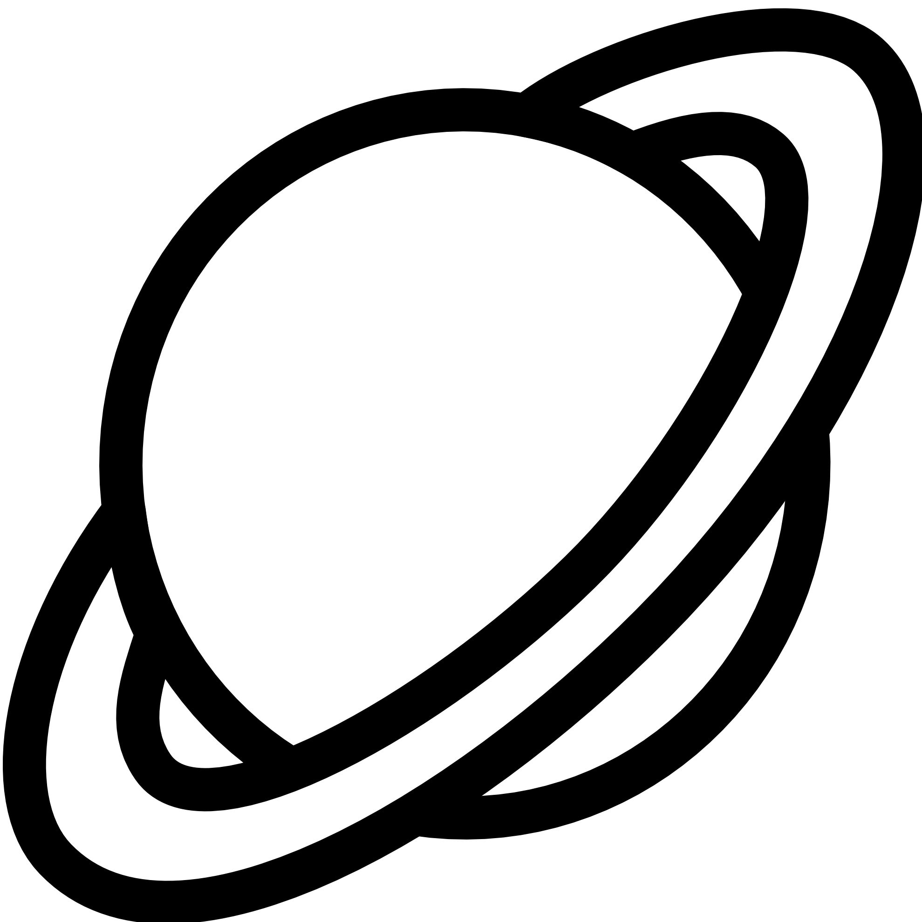
A Quick Recap
What is Gravity?
The force of Gravity is the natural phenomenon in which all objects with mass are pulled towards one another.
Where is Gravity?
Gravity can be observed anywhere and everywhere, at any time too. It is all around us all the time.

Slide 3
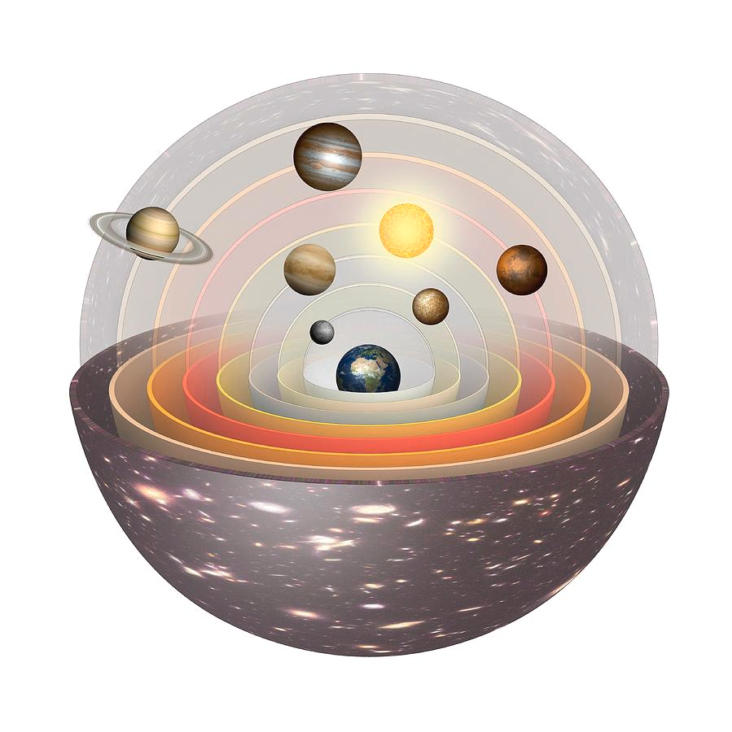
The Geocentric Model
The geocentric model was created by Ptolemy. Ptolemy did not have much information but used measurements of the sky. When he observed the sky, he deemed that Earth must be the center and that all of the other planets and the sun orbit around us.

Slide 4
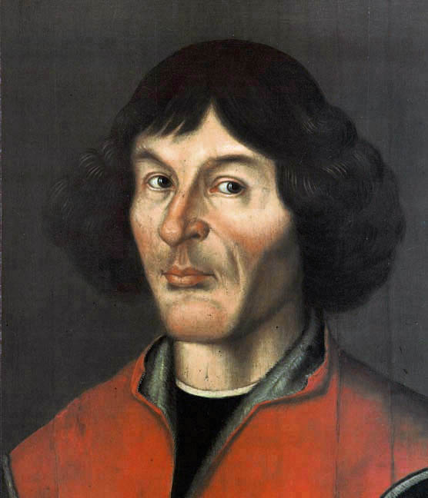
Nicolaus Copernicus
He proposed the idea that the Earth wasn’t the center of the Universe, but rather, the Sun was the center of the Universe. This was the Heliocentric model. He was killed for this belief. But it was the beginning of the Scientific Revolution.

Slide 5
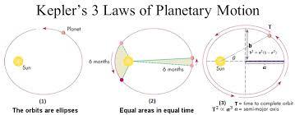
Three Laws of Planetary Motion
1
Developed by Johannes Kepler

Slide 6
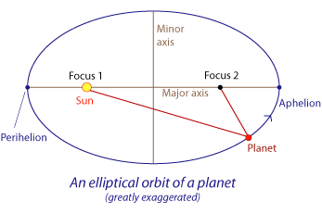
Kepler’s First Law
The Law of Ellipses details that all planets orbit in ellipses, with the sun as one focus point.
Slowest motion at the aphelion and fastest motion at the perihelion

Slide 7
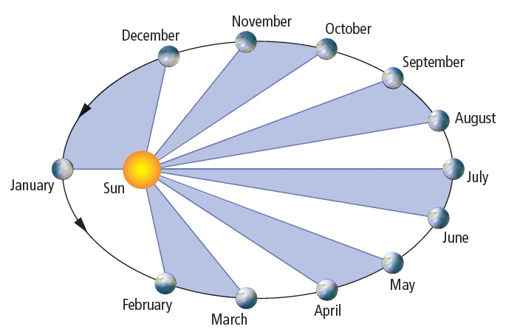
Kepler’s Second Law
The Law of Equal Areas shows how they orbit and that they are equal areas over equal intervals of time.

Slide 8
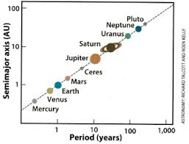
Kepler’s Third Law
T² ∝ r³
The Law of Harmonies is: the orbital period of a planet squared is proportional to its average distance from the sun cubed.

Slide 9
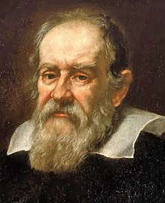
Galileo Galilei
He concluded that all objects, regardless of their weight, accelerate towards the Earth at the same rate.

Slide 10
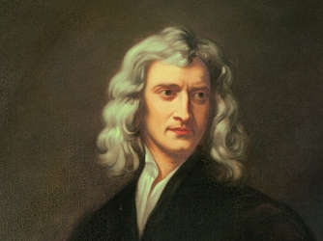
Isaac Newton
One of The Fathers of Physics

Slide 11
Isaac’s Contributions
He proposed that the moon is pulled by gravity towards the Earth.
He also proposed that gravity applied both here and everywhere.

Slide 12
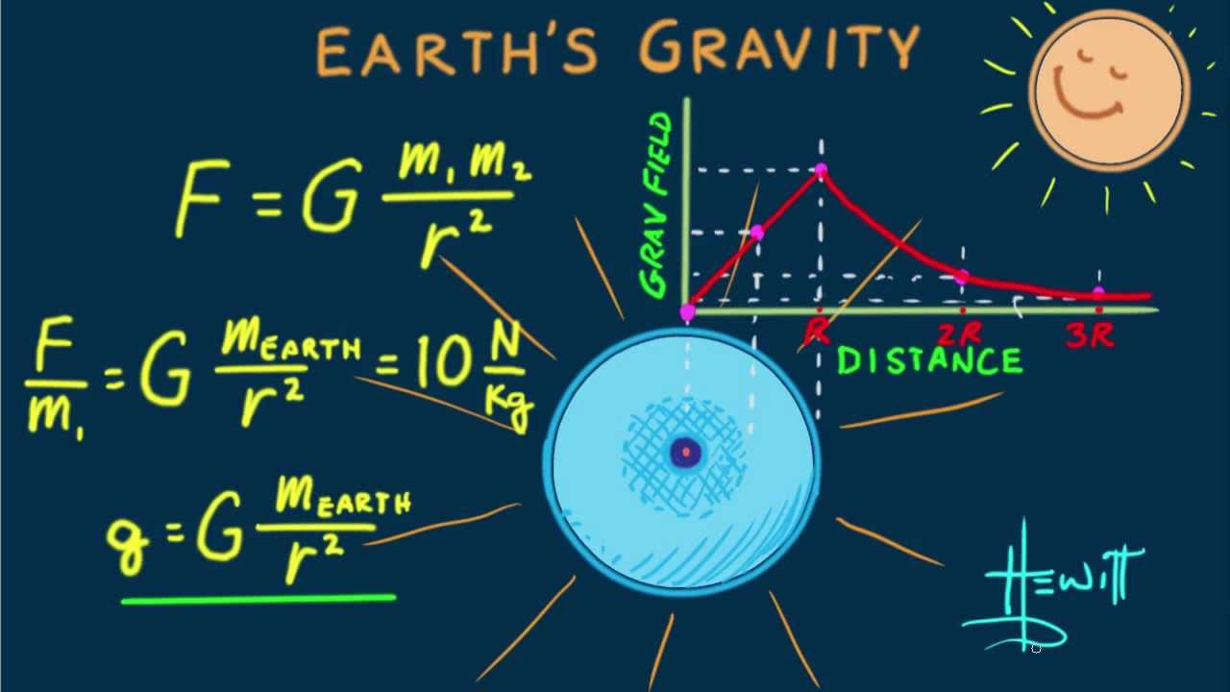
F ∝ m₁m₂/r²
The force of gravity is proportional to the product of the masses and inversely proportional to the distance squared.

Slide 13
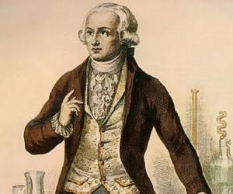
Henry Cavendish
F_{g}=Gm₁m₂/r²
G ≈ 7 * 10⁻¹¹

Slide 14
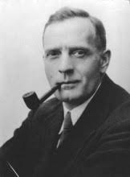
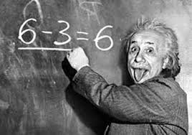
Notable People
Einstein
Interprets gravity as the curvature of spacetime.
Edwin Hubble
The Milky Way is not the only galaxy, and there are billions and billions of galaxies. The further away a galaxy was. The faster they are moving away from us.
The universe is constantly expanding.

Slide 15
Circular Motion
Centripetal Force
A force which points toward the center of rotation; literally means “center seeking” force.
Tangential Force
A force on a moving body in the direction of a tangent to the path of its body.
The two ingredients for Circular Motion are Centripetal Force and Tangential Force.

Slide 16
F_{c} = mv²/r
The centripetal force is equal to the product of the object's mass and velocity squared divided by the radius of the circular path.

Slide 17
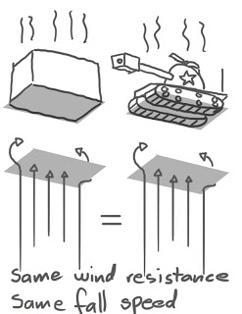
Common Misconceptions and Mistakes Pt.1
The center of the Universe is the Earth.
This has been disproved.
People in 0 gravity are floating.
They are in a perpetual free fall.
Heavier objects fall faster than lighter ones.
Disproved by Galileo.

Slide 18
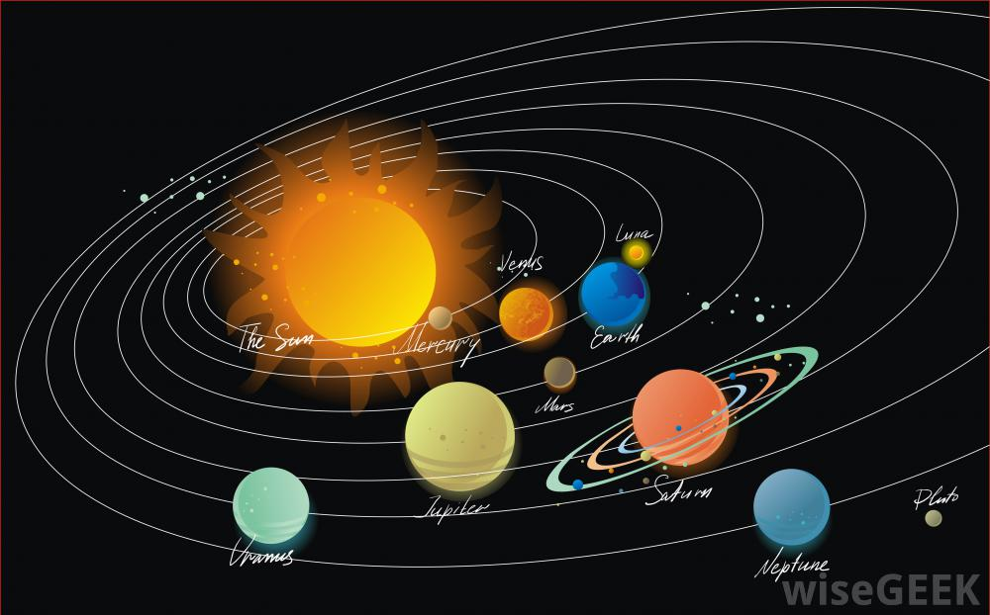
Common Misconceptions and Mistakes Pt.2
There is no gravity in space.
There is gravity everywhere, the gravity is just weak over there.
Planets move in circular orbits.
Orbits have been observed and proved to be elliptical.
People weigh the same on different planets.
People have different weights, but the same mass.

Slide 19
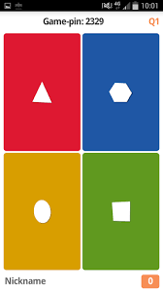
Place your screenshot here
KAHOOT LINK: https://play.kahoot.it/#/?quizId=d06936e0-a259-4506-b290-073d04a3af59

Slide 20
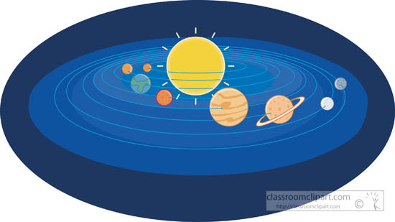
THANK YOU
FOR YOUR ATTENTION

