Slide 1
Scene III: Forces
By: Cassidy, Haig, Ali, Juliette, Jake, and Max

Slide 2
Topics We Will Cover
First Law of Motion
Law of Inertia
Mass
Weight
Second Law of Motion
Third Law of Motion
Normal Force
Friction
Pressure
Buoancy

Slide 3
The First Law of Motion

Slide 4
First Law of Motion
“An object continues in its state of rest or of uniform speed in a straight line unless acted on by an external, unbalanced force.”
The first law of motion appears in many aspects of Physics but is most important in motion, obviously, because it affects all types of motion.
The reason that this law applies to all motion is because air resistance is the unbalanced force that is applied. When an object is put into motion it will eventually stop due to this resistance. This is why it affects all motion.
When calculating, Motion Physicists always need to think about the First Law of Motion, and it is a common mistake to ignore this and get the wrong calculation.

Slide 5
Inertia
A body’s resistance to changes in its motion is its inertia.
Concept was initially created by Galileo. He reasoned that all moving objects of any form must eventually stop moving because of friction.
He then conducted experiments with balls and their behavior when sliding on slopes. He positioned the slopes with their ends meeting, it was then revealed to Galileo that the ball rolled down it’s “starting” slope and straight up and onto the other, but the ball did not reach the very top on the second slope, where it started on the first one. To account for this, Galileo stated that friction that was holding the ball back from travelling the exact same distance.
Inertia is always present in any object, regardless of whether or not said object is in motion or not.
The larger an object’s inertia, the larger mass it has.
The Law of Inertia IS the First Law of Motion

Slide 6
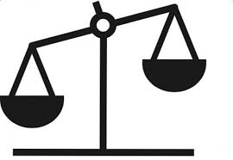
Mass
Mass is the measure of an object’s inertia (Mass and gravity are not the same)
Mass never changes no matter where you are
Mass is that quantity that is only dependent upon the inertia of an object
The more inertia that an object has, the more mass it has
A more massive object has a greater tendency to resist changes in its state of motion

Slide 7
Second and Third Law
of Motion

Slide 8
Second Law of Motion
The acceleration of an object is directly proportional to the net force acting on it and is inversely proportional to its mass
The equation is F_{net} = ma
The Net Force is measured in Newtons
Fnet =dp/dt
the net force = rate at which momentum changes with time
If you apply more force to an object, it accelerates at a higher rate
The acceleration of an object is dependent upon two variables - the net force acting upon the object and the mass of the object
As the mass of an object is increased, the acceleration of the object is decreased

Slide 9
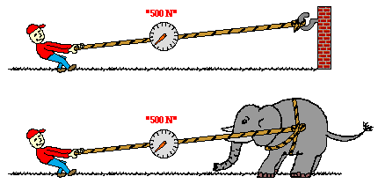
Third Law of Motion
Every Action has an equal opposite reaction.
Action and Reaction Pair Examples
A: A person opens the door.
R: The door pushes back on the person.
A: An angry coworker punches a wall.
R: The wall pushes back on the coworker. (ouch)

Slide 10
Weight
Weight = The force of gravity exerted onto an object
Weight changes depending on the force of gravity, for example your weight will be different on another planet since the gravity has changed.
W = mg (Weight = the product of the mass (m) of the object and the magnitude of the gravitational acceleration (g))
Measured in Newtons

Slide 11
R E C A P
First Law of Motion:
An object continues in its state of rest or of uniform speed in a straight line unless acted on by an external, unbalanced force
Second Law of Motion:
F = ma -- The acceleration of an object is directly proportional to the net force acting on it and is inversely proportional to its mass
Third Law of Motion:
Every action has an equal opposite reaction.

Slide 12
Friction

Slide 13
Normal Force
The normal force acting on an object is also known as the contact force.
The normal force is the force acting on an object when it is in contact with another object.
Important Note: In both math and physics, “normal” means perpendicular.
Notes:
-The Normal Force that is acting on an object is also known as the contact force and is essentially the force acting on an object when it is in contact with another object.
-An important thing to remember is that in both math and physics “normal” means perpendicular.

Slide 14
Friction
Friction appears in several different forms but it always opposes motions
These forms can be broken into 4 different types known as Kinetic, Static, Rolling, and Fluid friction.
Reminder: The force of friction is not affected by surface area or speed.

Slide 15
Types of Friction
Kinetic Friction - Also known as sliding friction, kinetic friction is the friction that acts when an object drags across a surface sliding against it.
Static Friction - This type of friction occurs when an object is static, or standing still and not moving at all.
Rolling Friction - As the name suggests, rolling friction occurs when an object rolls across another object or surface.
Fluid Friction - This type of friction happens when an object is moving through a liquid or another type of fluid, such as water.

Slide 16
F_{fr} ∝ F_{N}
The force of friction is proportional to the normal force.

Slide 17
Drag Force
The drag force on an object can also be called air resistance or fluid resistance is a part of fluid friction.
Generated by the interaction between a solid object and a fluid.
Unlike other types of friction, drag force is dependent on the velocity, or speed of the object moving through a fluid.
It is also dependent on the surface area of the object, making the drag force acting on an object different from other types of frictions.

Slide 18
F_{drag} ∝ Av²
Drag forces are proportional to the object’s surface area and the velocity squared.

Slide 19
Pressure

Slide 20
Pressure
p ∝ F/A
Pressure is proportional to the force applied and inversely proportional to the surface area.
Measured in pascals (Pa) ➤1 Pa = 1 N/m2 = 1 kg/m•s2

Slide 21
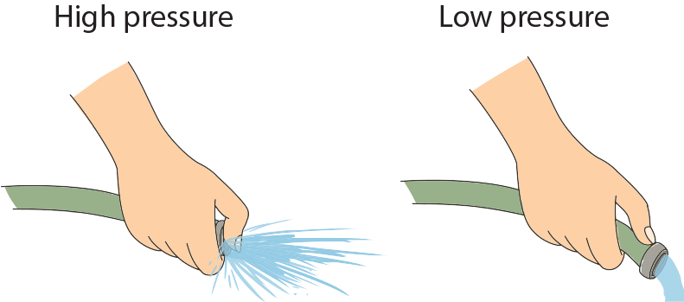
What is PSI used for?
Psi = Pounds per square inch.
Used to measure the pressure on an object. For example car or bike tires.
Some examples of Pascals :
1 Pa: A dollar bill resting on a flat surface.
200000 Pa : Usual tire pressure
1.322 × 10⁻¹¹ Pa : Outer space

Slide 22
Buoyancy

Slide 23
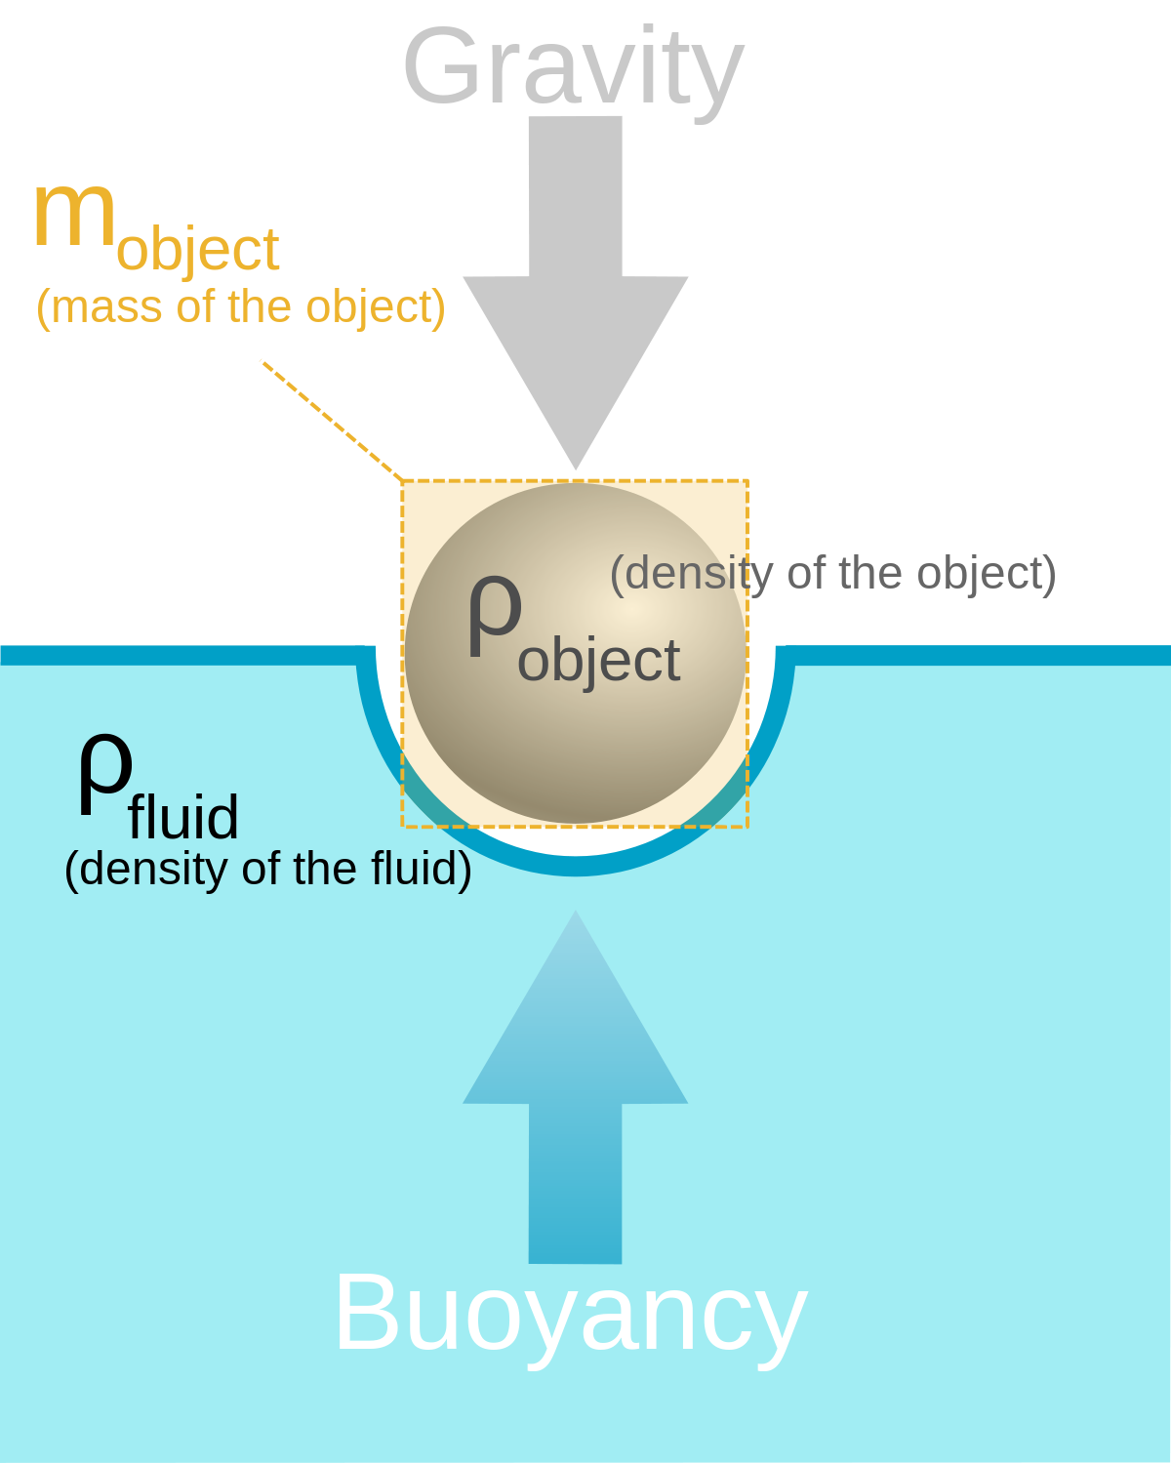
Buoyancy
Buoyancy is the the upward force that is exerted by a fluid and it opposes the object’s density and mass
Buoyancy is a very important force in terms of liquids, this is because it can have a different effect on a larger surface area and a higher weight which is what makes it very interesting.
The Buoyant force in measured in Newtons and we are able to calculate it with the equation F_{buoy}∝ V_{displaced}ρ_{fluid} the buoyant force is proportional to the volume of the fluid displaced and the density of the fluid
An easier way to see it is that the buoyant force is equal to the weight of the fluid displaced.

Slide 24
Buoyancy
Many people will commonly confuse this with just what makes something float.
The buoyant force is much more than that. It takes the densities of objects then based on how dense they are it will affect it a different way.
For example objects that are less dense than water do not need to displace as much water as let's say lead.
This makes the buoyant force much more important because it can be more or less powerful depending on how dense and object is.

Slide 25
Kahoot
https://play.kahoot.it/#/k/96e5077c-481f-41e6-a2b8-8ccfb0a126c2

Slide 26
Thanks for Listening
Good Luck on the Final

