Slide 1
Electrostatics
By: Riley Goodwin, Laurin Hwang, Reza Hemmati, Malia Nakasone, William He, and Haley Decker

Slide 2
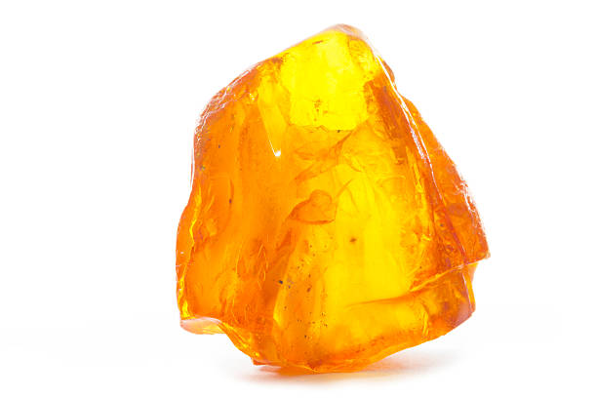
First Discovery
The first discovery was made by the ancient Greeks. They found out that if you rub an amber rod with a piece of cloth, the amber attracts small pieces of leaves or dust. Our first discovery of electricity was through investigating static.

Slide 3
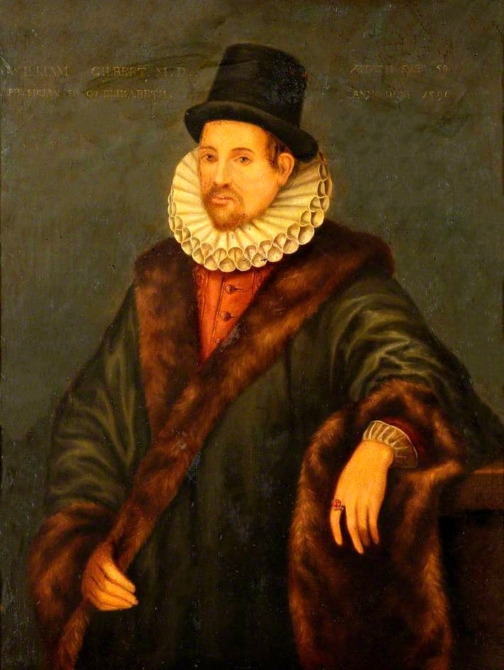
William Gilbert’s Founding(s)
William Gilbert: 1544-1603
William Gilbert found that some materials can be electrified, like amber, glass, gems, and other materials. But, he also found that others can not, like metals. He tested this discovery by trying to electrify different materials.
Some materials worked while some did not.

Slide 4
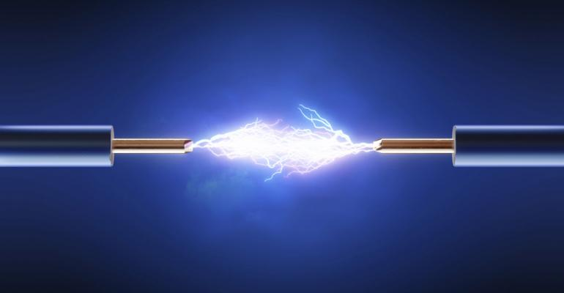
Electricity
After discovering electricity, we came to think of it as a fluid. So, when a substance such as amber was electrified, it was considered to have gained electric fluid.

Slide 5
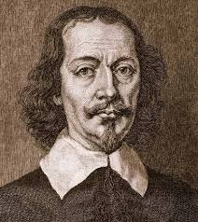
Otto Von Guericke’s Finding(s)
Otto Von Guericke: 1602-1686
Guericke found out that electrics display electrostatic repulsion and attraction, just like magnets. He discovered if any substance was brought near electrified sulfur, the substance would be temporarily electrified. This was the discovery of electrostatic induction.

Slide 6
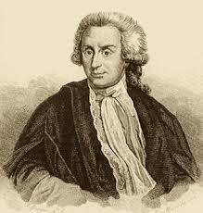
Stephen Gray’s Finding(s)
Stephen Gray: 1666-1736
Stephen Gray made the discovery that electricity moves with an experiment he made. (Next slide)

Slide 7
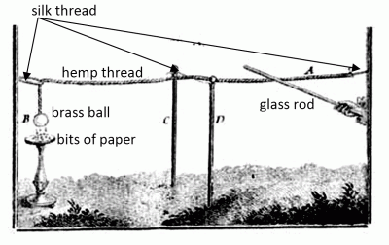
Stephen Gray’s Experiment
After rubbing the glass rod with a cloth, he touched the hemp rope with it. This caused the brass ball on the other side to become electrified.
This made him think that electricity wanted to spread out as much as possible through a substance. So, electricity moves.

Slide 8
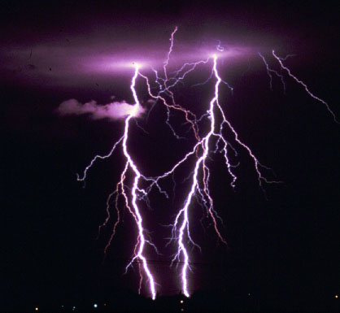
Moving Electricity
Even though electricity moves, it doesn’t spread through all materials very easily.
Electrics, like a glass rod, could be connected to a charged sulfur sphere and the ground, but nothing would happen.
But when a conductor, like an iron rod, is connected to charged sulfur sphere and the ground, the sphere would immediately lose all of its charge. The electricity would drain into the ground, where it would spread so it no longer could be detected.
This explained why metals couldn’t be electrified by rubbing them, because when a charge was placed on a metal, the metal would immediately want to get rid of it.

Slide 9
Conductors And Insulators
Conductors - materials that allow the passage of electricity with great readiness
Insulators - materials that resist the flow of electricity

Slide 10
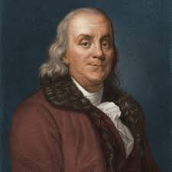
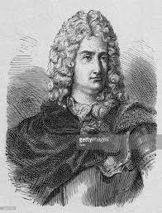
Charles François Du Fay’s and Ben Franklin’s Finding(s)
Charles François Du Fay: 1698-1739
Du Fay discovered that there are two types of electric fluid which he named vitreous electricity, from the Latin word for glass, and resinous electricity.
Ben Franklin 1706-1790
In the 1740s, Franklin conducted experiments which showed that a charge of vitreous electricity could neutralize a charge of resinous electricity, leaving no charge at all behind. Franklin’s theory was simple: there’s only one fluid. When that fluid is present in normal amounts, the object is neutral. If there’s too much of the fluid, Franklin considered the object positively charged; and if there’s a deficit, he considered it negatively charged.

Slide 11
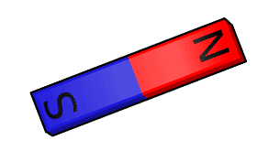
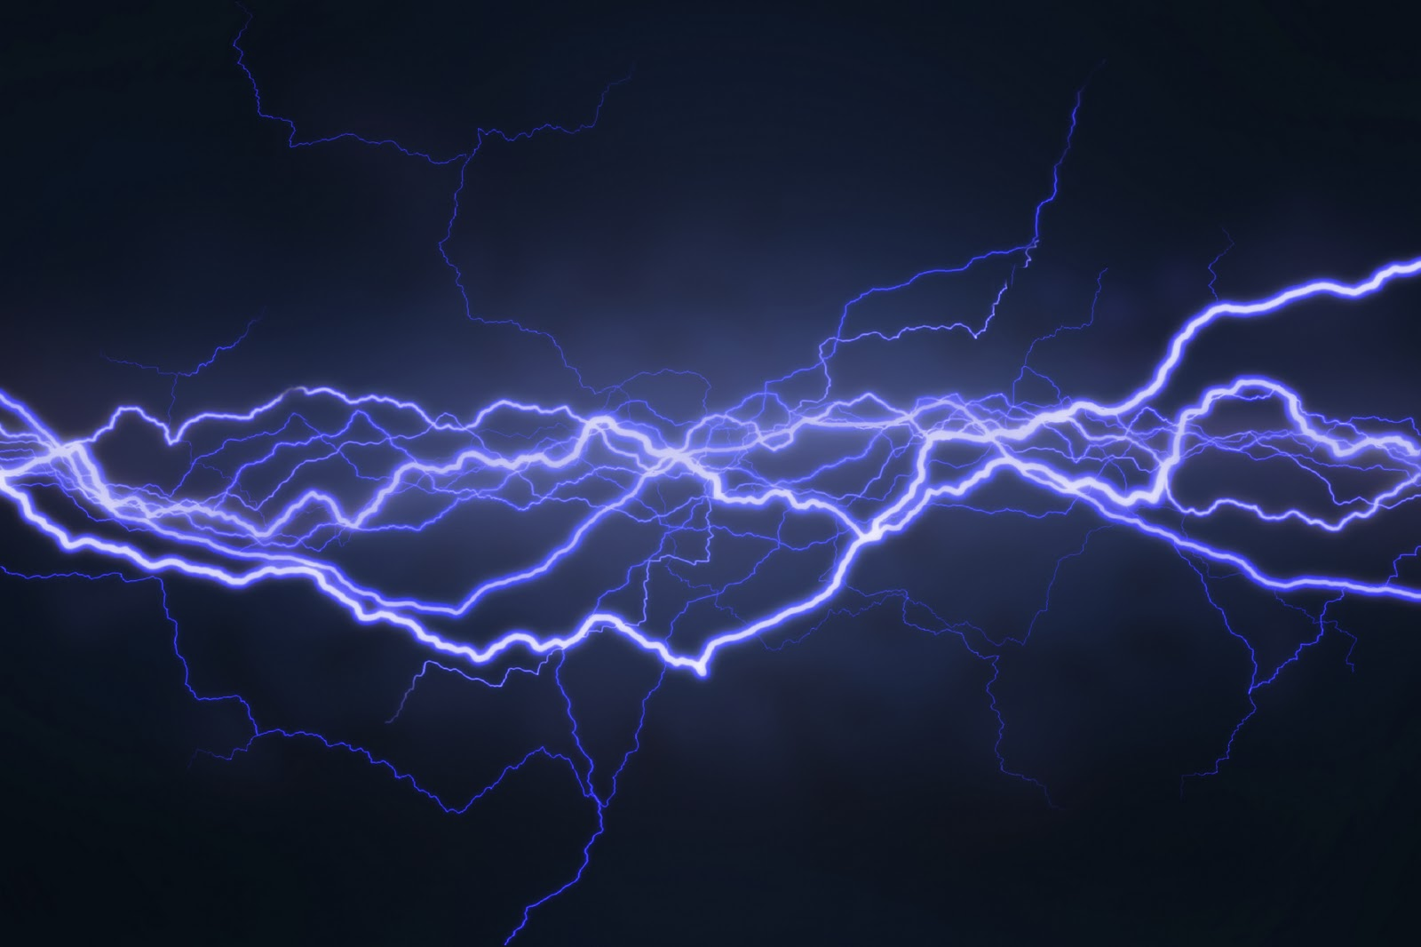
Difference in Electricity? No.
Finding the difference between magnetic poles is easy, which is north and which is south?
But electricity is different, there’s no such thing as different electricity, it’s all the same. The two forms, vitreous and resinous, only differ in reference to each other.

Slide 12
Charge is CONSERVED
The Law of Conservation of Electric Charge
Electric charge can neither be created nor destroyed. Any net charge gained must come from somewhere else, and any net charge lost could always be found in another place.

Slide 13
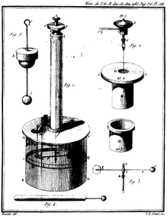
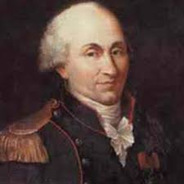
Charles-Augustin de Coulomb’s Finding(s)
Charles-Augustin de Coulomb 1736-1806
Coulomb was a French scientist who measured electrostatic force and how it scaled with charge and with distance, he did the same with magnetism. Coulomb used a torsion balance to measure the electrostatic force in much the same way Cavendish had with the gravitational force. Coulomb’s experiments demonstrated that the electrostatic force, like gravity, obeys the inverse square law.

Slide 14
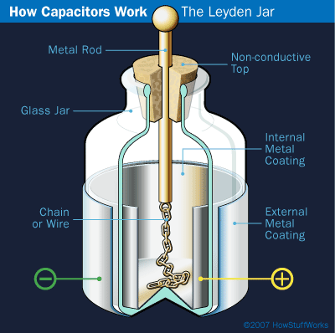
The Leyden Jar
The Leyden Jar was invented by Ewald Georg von Kleist and by Pieter van Musschenbroek of Leiden (Leyden) in 1745-1746. It is a device that stores static electricity between the two electrodes on the inside and outside of a glass jar.

Slide 15
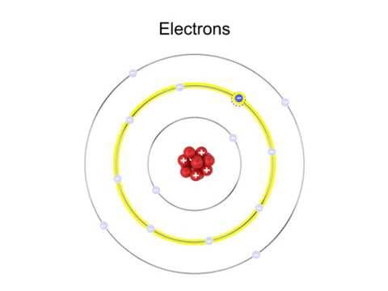
Electrons
Electricity is made out of particles, later are electrons, which are pulled from the atoms of the material.
The electrons are all exactly the same no matter what the material or substance they come from.
Electrons are negatively charged.

Slide 16
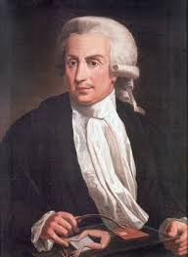
Luigi Galvani’s Finding(s)
Luigi Galvani 1737-1798
He observed that an electric spark from a Leyden jar could cause the muscles in a dead frog’s leg to twitch, and he thought it was some “animal electricity”.
He discovered that all you need to reproduce the same result is two different metals contacting the muscle simultaneously.

Slide 17
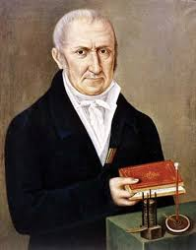
Alessandro Volta’s Finding(s)
Alessandro Volta 1745-1827
He overlooked Galvani’s experiment and suspected that the electric charge might be from the metals rather than from the muscle. He invented the electric battery through the Crown of Cups which provided the first source of continuous current.
The volt (V) was named after him.

Slide 18
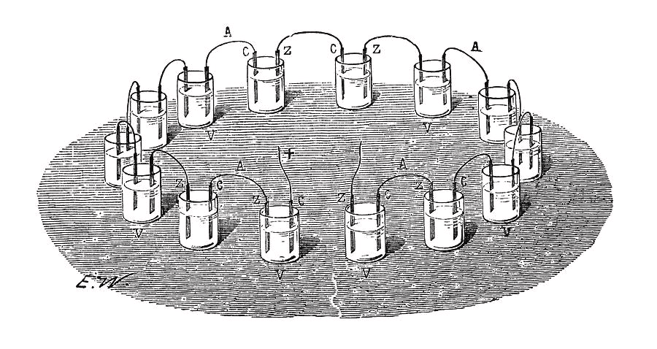
The Crown of Cups
The Crown of Cups was an experiment done by Volta. He connected a circle of cups together, each cup with a rod of copper and a rod of zinc coming in and out of it. The cups are half filled with salt water and it produced a continuous source of electric current. Volta invented the first
“battery”, but it took another whole century for the scientists to understand why it worked.

Slide 19
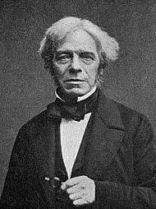
Michael Faraday’s Finding(s)
Michael Faraday: 1791-1867
Faraday contributed to the study of electromagnetism and electrochemistry. He challenged people to think of electricity and magnetism as fields. He discovered the fundamental relationship that connects electricity and magnetism, later using this knowledge to develop the first electric motor and generator.

Slide 20
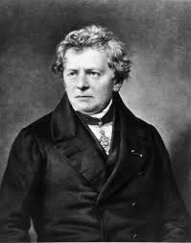
Georg Simon Ohm’s Finding(s)
Georg Simon Ohm: 1789-1854
Ohm was a German physicist and mathematician. He looked for a relationship between the voltage supplied by a battery and the rate at which the current of electric charge flowed between two points to help further his studies on electricity. He later found that the amount of current flowing through the wires was proportional to the voltage applied to it.

Slide 21
Ohm Continued
Electric Current — the rate of flow of electric charge, i.e. how much charge moves past per second (measured in amps [A])
Voltage — the amount of energy supplied per charge (measured in volts [V])
Ohm also went and experimented what effect the wire had on the flow of current by changing the qualities of the wire (material, length, etc.). He found that this also changed the flow of the current.

Slide 22
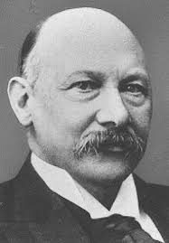
Heike Kamerlingh-Onnes’s Finding(s)
Heike Kamerlingh-Onnes: 1853-1926
Onnes made low temperature physics research possible for the first time because he managed to liquify helium in 1908. Also in 1911, he found that the resistance of mercury grew smaller and smaller in expected fashion as temperature decreased, but the resistance dropped suddenly to exactly zero at or below temperatures of 4.16 K

Slide 23
Other Important Findings
J.J Thomson discovers the electron
Electricity is made of subatomic particles (later dubbed electrons) which which are pulled from the atoms of the material
The electrons are all exactly the same no matter what material or substance they come from (same mass, same charge, etc.)
The electron is negatively charged

Slide 24
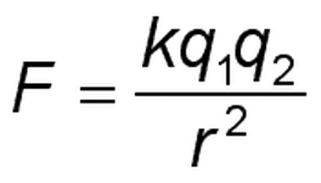
Common Misconceptions/Mistakes
1. Using Coulomb’s Law, a negative or positive sign for the electrostatic force doesn’t determine the quality of the charge between the two objects, it just dictates whether the two charges are attracted by the force or repelled.
“Positive” force
“Negative” force

Slide 25
Common Misconceptions/Mistakes
2. Don’t forget to square r, as this is the most common mistake surrounding this equation.

Slide 26
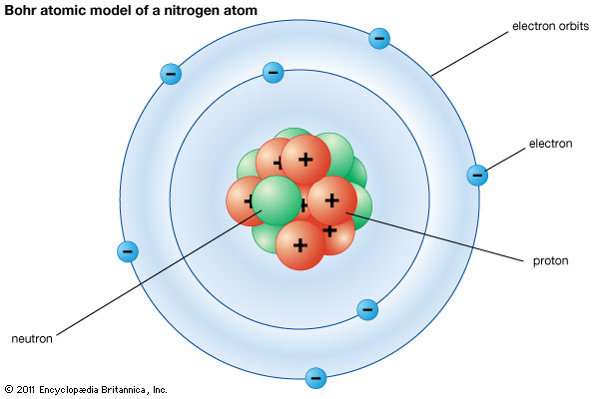
Common Misconceptions/Mistakes
3. Protons don’t move from atom to atom, they stay in the nucleus; electrons do the moving to create charges, an excess of electrons meaning that the object is negatively charged and a lack of electrons meaning that the object is positively charged.
Usually, the electrons on the outer layer of the atom move from atom to atom if a strong enough electrostatic force is introduced.

Slide 27
Common Misconceptions/Mistakes
4. All “forms” of electricity are the same-”positive” and “negative” electricity don’t exist. Electricity is made of identical subatomic particles, electrons, that travel from atom to atom.

Slide 28
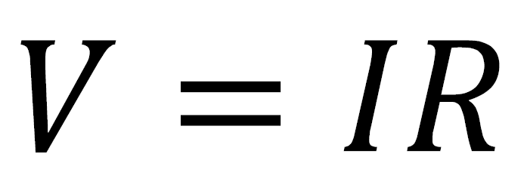
Common Misconceptions/Mistakes
5. While voltage is on the left side of the equation, isolated from the other variables, it isn’t the dependent variable-the dependent variable is current, I. So, to fix this, you could reform the equation to isolate I and end up with I=V/R.

Slide 29
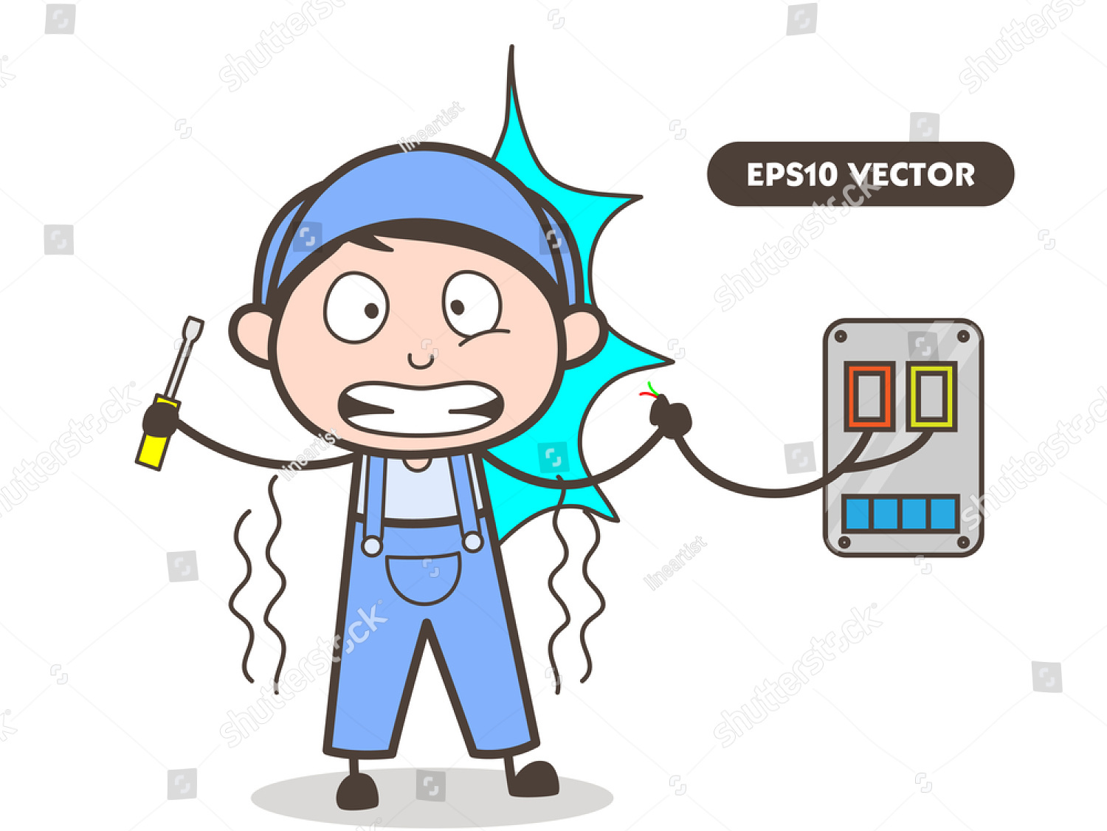
Common Misconceptions/Mistakes
6. Current doesn’t always flow if the path is closed and in a loop-there needs to be a voltage difference. Current is directly proportional to this voltage difference.
In this example, current travels from the wires to the tool because there is a voltage difference between the the two-as a result, the person is shocked.

Slide 30
Works Cited
Fulmer, Nate. “Lecture Fields & Forces at a Distance.” Fulmerphysics.weebly.com, <https://fulmerphysics.weebly.com/uploads/5/8/1/6/58166071/lecture_fields___forces_at_a_distance_v1.1.pdf.>
Katz, Eugenii. “Pieter (Petrus) Van Musschenbroek.” , Web.archive.org, <web.archive.org/web/20090326073456/http://chem.ch.huji.ac.il/history/musschenbroek.htm.>

Slide 31
Kahoot
https://play.kahoot.it/#/k/24cad1cc-1cf7-47a7-8ef7-8560d9e09efc

