Slide 1
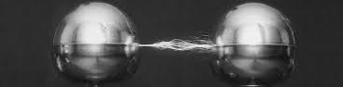
Electrostatics
By:Jayli, Natalie, Evan, Daniel, Declan, Luke

Slide 2
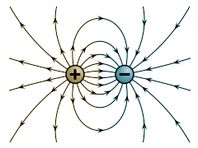
Review of Electrostatics
The study of stationary electric charges or fields as opposed to electric currents
Branch of Physics
Unlike charges attract - like charges repel
Charge is conserved
Conductor - material that allows electricity to flow easily
Insulator - a material that does not allow electricity to flow easily
Electroscope - device used to indicate the existence of charge
Coulomb's Law - Gives the magnitude of electrostatic force between two objects
Like magnets, electrics display electrostatic repulsion as well as attraction
Electricity doesn’t spread throughout all materials with equal ease

Slide 3
More Review
Some materials discharge their electric charge faster than they can gain it
Matter can be described as two categories: electric insulators and electric conductors
Two types of electric fluid: vitreous energy and resinous energy
The charge of vitreous electricity can neutralize a charge of resinous energy
Electric charge can neither be created nor destroyed
The electrostatic force is proportional to the product of the charges and inversely proportional to the distance squared
Amount of current flowing through a wire is proportional to the voltage applied to it
Voltage is equal to the product of the current and resistance.

Slide 4
Even More Review
Electrical resistance of a material is proportional to the length and inversely proportional to the cross-sectional area of the material that the current must pass through
Electricity is made of subatomic particles (later dubbed electrons) which which are pulled from the atoms of the material
The electrons are all exactly the same no matter what material or substance they come from (same mass, same charge, etc.)

Slide 5
Conductors and Insulators
A conductor is a material that allows electric current to pass through efficiently.
Good conductors are metals such as gold, copper, aluminium.
Metals conduct electricity because metal atoms have electrons that are not tied into any other atom. So electrons are freely flowing throughout a metal.
Insulators oppose electricity and do not let electric current to pass through.
Some insulators are wood, glass, or rubber.
Insulators have very tightly packed electrons

Slide 6
Coulomb's Law
Coulomb's law - measures the magnitude of electrostatic force between two objects
F=kq1q2/r^2
^ Force= Constant x Charge 1 x Charge 2 / Distance Squared
Force is proportional to the strength of each charge.
When the two charges have the same sign (positive or negative), the force between them is repulsive because like charges repel.
When the charges have opposite signs, the force between them is attractive because unlike charges attract.
Measured in coulombs (C)

Slide 7
Resistance
Electrical resistance is the measure of how difficult it is for electrical current to pass through
It depends on the type of material
A good conductor means less resistance
It’s symbol is R
The formula is V/I=R
It is measured in Ohms(Ω)

Slide 8
Current
The rate of flow of electric charge
How much charge moves past per second
It’s symbol is I
It is measured in Amps. [A]
It is calculated by V/R
People say that it is the current that kills you

Slide 9
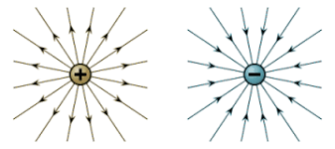
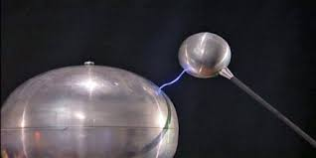
Common Mistakes
When distance is applied, people do not think to use the inverse law.
The unit I actually stands for current.
Electrons are all the same, no matter the materials or substances they originate from.
The difference in voltage results in a magnetic field which creates a charge.
People can confuse the poles which means your experiment could be messed up if it was meant to attract instead of repel.
Electricity sometimes moves, but doesn't actually move or charge anything

Slide 10
Multiple Questions -
There are two objects. One is positively charged and the other is negatively charged. Will they
Explode
Repel
Attract
Not do anything

Slide 11
What is Electric current measured in
Volts
Amps
Ohms
Coulombs

Slide 12
Electrical Conductors do what
Allow electricity to flow with great readiness
Do not allow electricity to flow through
Let people on a train
Direct a musical performance

Slide 13
What conductor is good for electricity?
Wood
Brick
Copper
Concrete

Slide 14
What do insulators do
Allow the passage of electrical current
Sleep
Do not allow the passage of electrical current
Eat food

Slide 15
What object is good for insulating?
Steel
Undistilled Water
Copper
Wood

Slide 16
What is the symbol for Current
C
K
I
A

