Slide 1
Momentum
By: Ariel, Adam, Patience, Mahyar, Rio, and Claire

Slide 2
The Basics
Momentum A vector quantity of motion
p=mv
This equation says that momentum is equal to the mass of the object times its velocity.
That means that an object with little mass and a high velocity has the same momentum as an object with a lot of mass and a low velocity.
Momentum is measured in kg* m/s

Slide 3
Law of Conservation of Momentum
The total momentum of an isolated system remains constant
More specifically: When object 1 and object 2 collide in an isolated system the combined momentum of the two objects before the collision, equal the total momentum of the objects after
So no momentum was lost or gained

Slide 4
The Different Types Of Collisions
Elastic Collisions - A Collision during which no deformation takes place. (Or at least very little.)
Inelastic Collisions - a collision during which deformation takes place.
Perfectly Inelastic Collisions - A collision where the objects stick together after colliding.

Slide 5
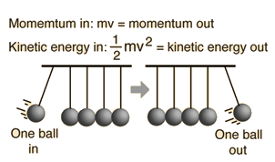
Elastic Collision
A good elastic collision is when there is no loss in potential energy.
Almost no energy is lost to sound, heat, or deformation.

Slide 6
Inelastic Collision
Is a collision in which the kinetic energy will change to some type of different energy in the collision.
Momentum is conserved in an inelastic collision
Example: A car crashing against a tree because the kinetic energy is not conserved.

Slide 7
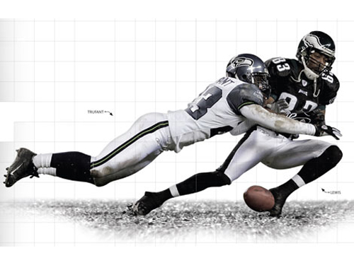
Perfectly Inelastic Collisions
In a perfectly inelastic collision, the maximum amount of velocity is lost in the collision.
Most Often in a perfectly inelastic collision the two objects stick together.
A good example of this is a tackle in Football

Slide 8
After collision
After a collision the mass will be doubled if the two objects have the same mass, and the speed will be the average of the two.
For example: V1= 24 m/s V2= 0(at rest) - before collision
V1= 12 m/s & V2 = 12 after collision

Slide 9
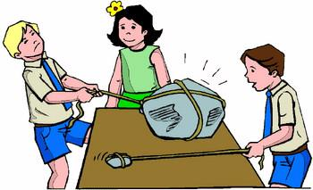
Newton’s 2nd Law
F=ma
The force is equal to the mass times the acceleration.

Slide 10
Impulse
dp=/ fnet dt

Slide 11
Common Mistakes
You can forget to convert the units so they are the same.
In conservation of momentum, you might think that because two object have collided only one of them is moving.
You might think that perfect inelastic collisions have no deformation at all.
You can confuse momentum with the idea of velocity. Though velocity is needed to find momentum, they are not the same thing.
Impulse means only the time of force applied. But, this is not true, as impulse describes the amount of force applied over a certain time.
That it isn’t a vector quantity, meaning direction doesn’t matter.

Slide 12
Review
If a 5kg object has a velocity of 10 m/s, how much velocity does it have?
If object 1 and object 2 have the same mass, and object 1 has a velocity of 20 m/s and object 2 has a velocity has a velocity of 30 m/s, how much momentum would they have together if they had a perfect inelastic collision.
What type of collision is a tennis ball being thrown on the ground?

Slide 13
Review (cont.)
If an out of control car crashed into either a bean bag or a brick wall, which instance would have the least amount of damage? Why?
If a 1000g object has a velocity of 5 m/s how much momentum does it have?

Slide 14
Work Cited
Elastic and Inelastic Collisions, hyperphysics.phy-astr.gsu.edu/hbase/elacol.html.
http://www.physicsclassroom.com/class/momentum/Lesson-2/Momentum-Conservation-Principle
n/a. “What Are Momentum and Impulse? (Article).” Khan Academy, Khan Academy, 0ADAD, www.khanacademy.org/science/physics/linear-momentum/momentum-tutorial/a/what-are-momentum-and-impulse.

