Slide 1
Magnetism/Circuits
By: Emaan Qazi, John Weiss, Marcela Rejas, Solange Aguero, Daniel Pinski, Thomas Decker

Slide 2
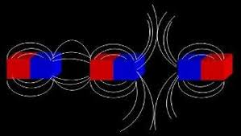
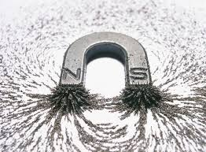
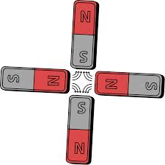
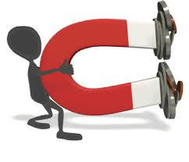
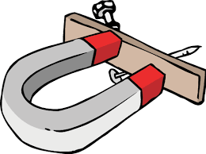
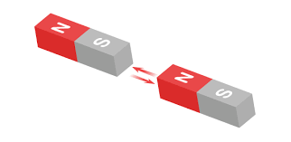
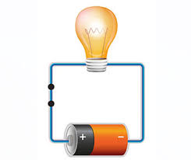
Magnetism

Slide 3
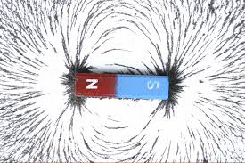
What is Magnetism?
Magnetism is the aspect of the combined electromagnetic force
It comes from the physical phenomenon arising from force cause by magnets
At the end of each magnet are poles, like poles repel, unlike poles attract
It’s fields are generated by rotating electrical charges
Magnets have south and north magnetic poles
It’s magnitude depends on the charge, velocity and
And strength of the magnetic field

Slide 4
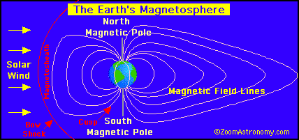
The Magnetosphere
Has a mix of electrically charged particles, and electric and magnetic phenomena rather than gravity regulating its structure.
Other planets in the solar system have magnetospheres, but Earth has the strongest one out of all the rocky planets.
Earth's magnetosphere is an extensive, comet-shaped bubble, that has played a decisive role in our planet's livability.
Earth’s Magnetosphere is part of a dynamic → responds to solar, planetary, and interstellar conditions.

Slide 5
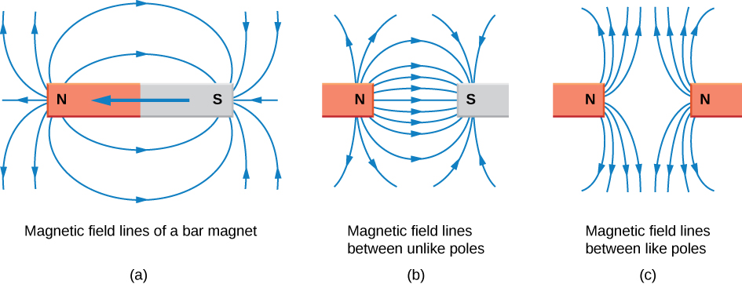
Magnetic Field Lines
Introduced by Michael Faraday.
First called the lines of force but then got called Magnetic Field Lines.
Most of the time, field lines of the Earth start near the south pole of the Earth, then curve around in space and finally meet again near the north pole.
Very useful in seeing the strength and also direction of the magnetic field.
Describes direction of the magnetic force of a north monopole at any direction that is given.

Slide 6
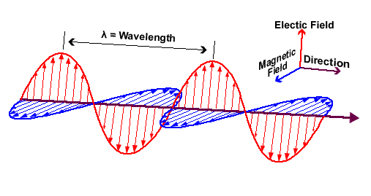
Electromagnetic Waves
In physics, electromagnetic radiation refers to the waves of the electromagnetic field, transmitting through space-time, which carries electromagnetic radiant energy.
A special type of wave that can travel without a medium.
Electromagnetic waves are named the fact that they have both an electric and a magnetic component.

Slide 7
Magnetism misconceptions
All metals are magnetic
Turns out that most metals are nonmagnetic such as metals like Copper, Zinc, and Gold
2) Magnet are the only object able to produce a magnetic field
Magnetic fields are produced by north and south poles which every object has even our own planet is reliant on its magnetic field.
3) The magnet that is the largest will have the strongest magnetic force
The strength of the magnet is based on the metal it is made out of, so metals like iron will mainly dominate, but larger magnets can create larger fields which means the metal will probably be attracted to the larger magnet first

Slide 8
Magnetism misconceptions continued
4) Magnetism acts as a linear force that grabs other objects through a line of magnetism
Magnetism is a field force with a north and south pole and has the magnets act as a centripetal force for the magnetism
5) putting magnets under extreme temperature can make them weaker
This is only half true because heat can speed up atoms and lessen the magnet’s strength, but extreme cold can slow down the atoms which will in turn make the magnet have a stronger force.
6) The north pole of the earth is the magnetic north pole
The north pole is actually a magnetic south pole, which is why the north end of magnets attract to it

Slide 9
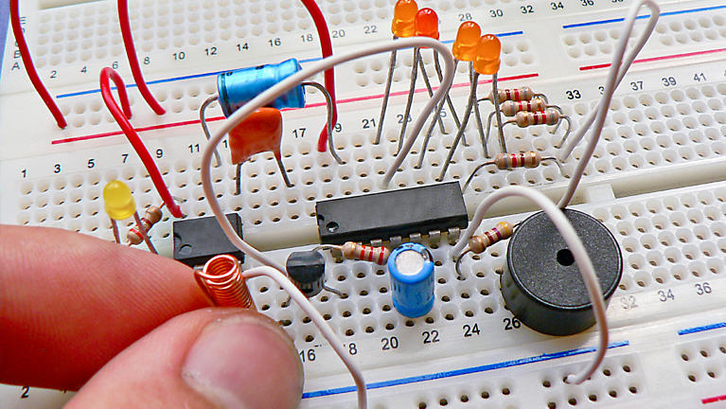
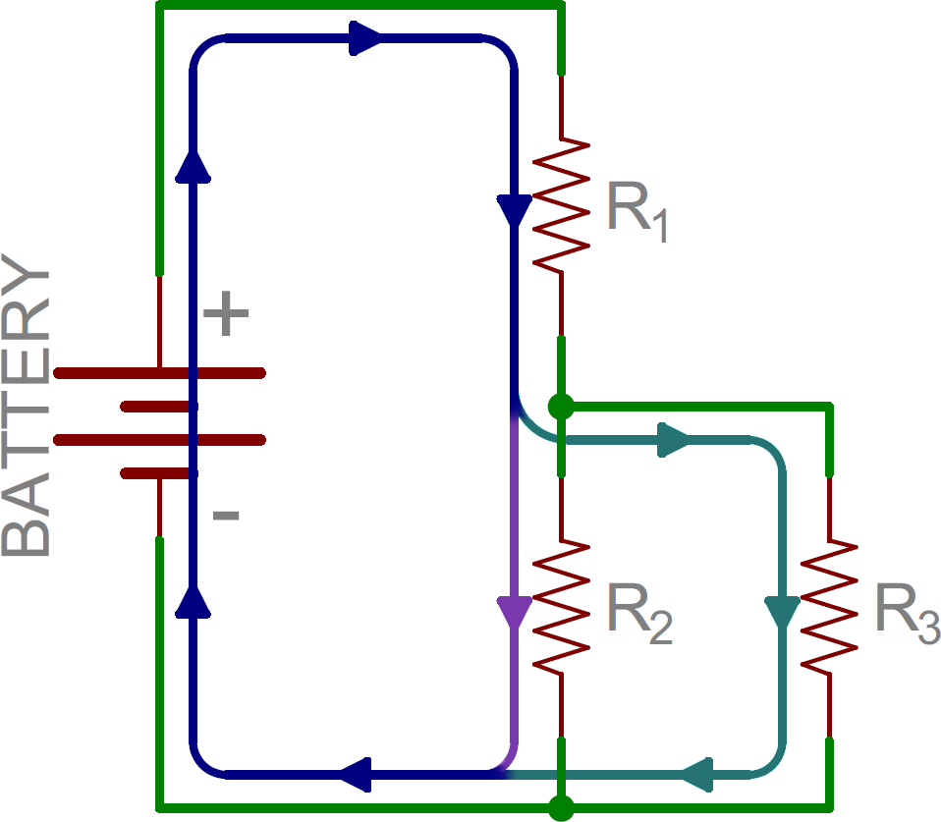
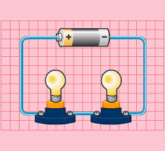
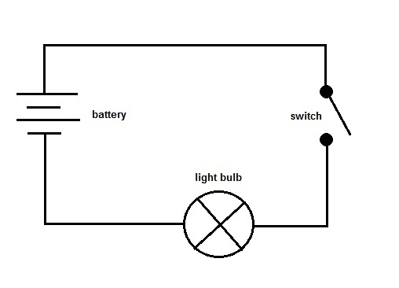
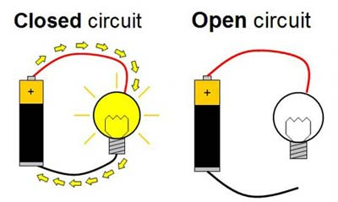
Circuits

Slide 10
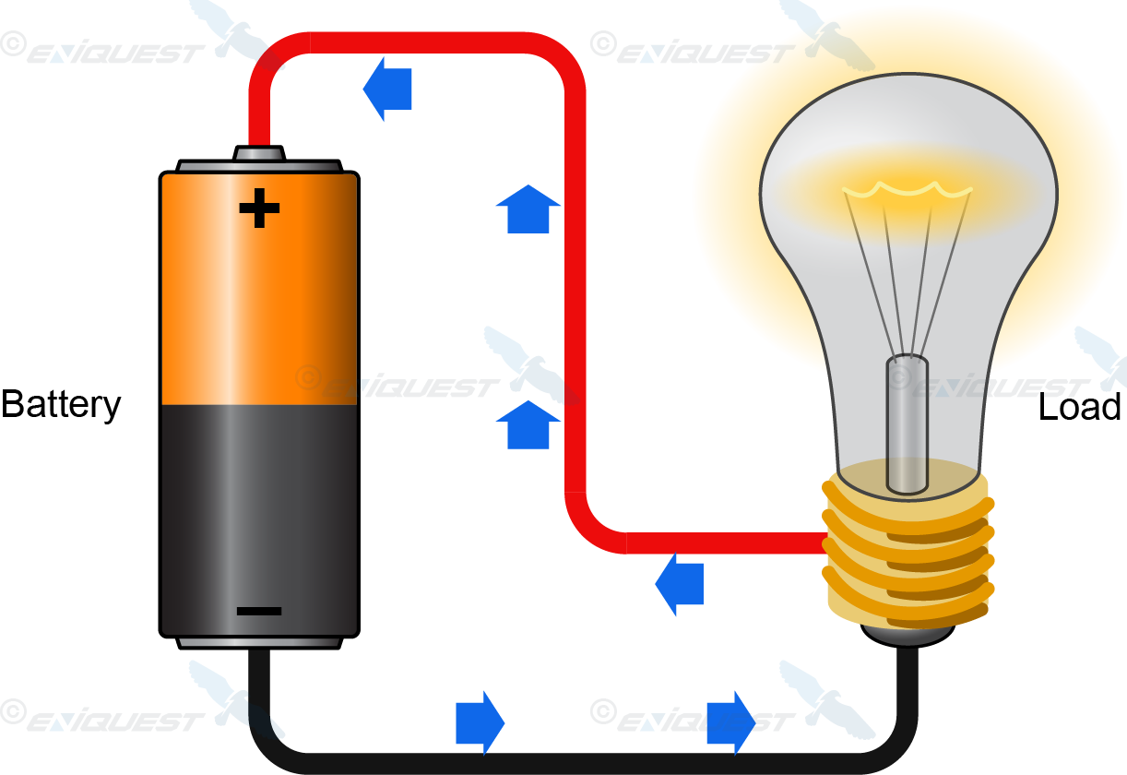
Electric Current
An electric current is the flow of an electric charge.
The electric charge is carried by moving electrons in a wire. (1.60217662 × 10⁻¹⁹ C)
I= Q/t
Current = charge / time
It is measured in amperes (A)

Slide 11
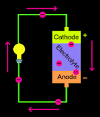
Batteries
Batteries PUSHES charge ; not create
Uses a chemical reation to create a voltage difference
Cathode (+) and Anode (-) Side
Electrolytes create a difference of charge in the two different metals
Cathode = metal oxide
Anode = carbon

Slide 12
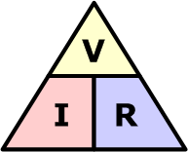
Ohms
V=IR
Voltage is equal to resistance times current
Voltage = the amount of energy supplied per charge
R∝L/A
Resistance is directly proportional to the area of the cross section and inversely proportional to the length

Slide 13
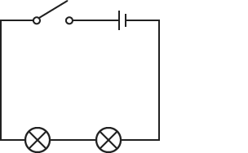
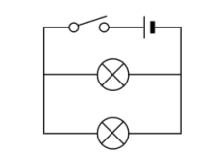
Types of Circuits
Series
Closed Loop
Only one path
Charge gets divided up among the resistors
Parallel
Each device has their own separate branch
Multiple pathways
Charge can go to any branch

Slide 14
Common Misconceptions
Batteries create charge
2. Electricity flows at the speed of light!
3. When electric currents die, they have no more charge
4. The power company gives you millions of electrons (charge)

Slide 15
Practice!
https://play.kahoot.it/#/k/f0f31970-9e75-48e3-b541-45a5bcabeae8

Slide 16
Question: What's one way to make the magnetic field stronger?
Put it under extreme heat
Rub them on your computer
Put it under extreme cold
Break the magnet between the north and south pole
c) Put it under extreme cold

Slide 17
Question: What do magnetic field lines describe?
Answers:
Describes how far it is from the monopole.
Describes direction of the magnetic force of a north monopole at any direction that is given.
Describes how long it will take from monopole to monopole.
b. Describes direction of the magnetic force of a north monopole at aaaaaany direction that is given.

Slide 18
A wire has a steady flow of 100 A how much charge passes through it as in 2 hours?
720,000 C
200 C
12,000 C
720,000 A
720,000 C

Slide 19
How does a battery move charge?
The battery creates a lot of charge pushing the electrons through the wire by causing an overflow of electrons.
It creates a voltage difference, making the electrons move from negative to positive
There are little humans in the wire that pushes the charge through the wire
It creates a voltage difference, making the electrons move from positive (cathode) to negative (anode)
b) It creates a voltage difference, making the electrons move from negative aaa to positive

Slide 20
What makes a magnet stronger
Making the magnet bigger
Cut the magnet in half
Use a better metal
C) Use a better metal

