Slide 1
Magnetism and Circuits
By: Ethan Kim, Hee Yong Chung, Mihir Sukhatme, Gavin Choi, Jacob Hardy, Gloria Gong

Slide 2
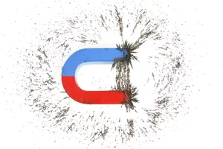
Magnetism and The History Behind It
Magnetism is a force that comes from the movement of electric particles.
First investigated by William Gilbert
Really discovered as early as 600 B.C. but scientists only began to understand it in the twentieth century
Notes:
According to tradition, the first person to make a systematic study of magnetic effects was the Greek philosopher/mathematician/astronomer Thales Certain naturally occurring types of iron ore (called “lodestones”) were found to attract iron and, as far as the ancients could tell, nothing else
Because the lodestones Thales studied purportedly came from his neighboring town of Magnesia, such iron-attracting materials were later dubbed magnets
Thales was also the one to discover the static-electrical “amber effect,” but because magnetism was so much easier to study than electricity, of the two magnetism got most of the attention for the next two thousand years

Slide 3
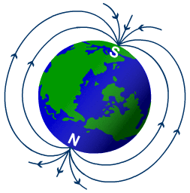
Magnetism Continued
William Gilbert actually did discover that the Earth is a weak magnet.
James Clerk Maxwell was one of the first to find out that magnetism and electricity are just different aspects of the same force field
The modern day understanding of magnetism is a theory on motions and interactions of electrons in atoms

Slide 4
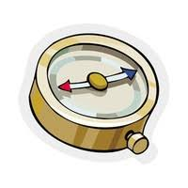
Magnetism Cont’d
Hans Christian Oersted performed an experiment.
When he turned on a battery, the needle of a compass pointed away from north, and shifted towards the battery
From this, he was able to deduce that the flow of electric current produces a magnetic field
And vice versa, the changing of a magnetic field, changes the voltage
Tiny magnets found in nature have little electric currents running through them

Slide 5
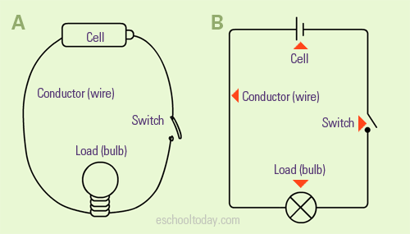
What are Circuits?
A circuit is a path or a line with an electric current flowing within.
A closed circuit makes electric flow possible. This closed circuit is usually a loop.
A common circuit contains conductors, a switch, a load, and a cell.
What a usual circuit looks like

Slide 6
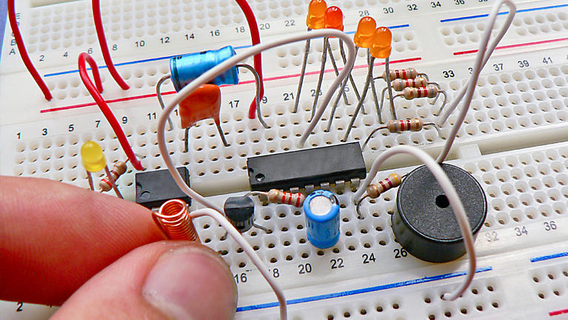
Circuits Conti..
Early investigations date back to thousands
The first battery ( an object that could produce a continuous flow) was created by Alessandro Volta.
Thomas Edison made the first light bulb using the practicality of electric current

Slide 7
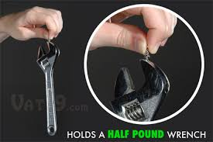
Common Misconceptions about Magnetism
All magnets are made of iron
This is actually false. Although irons are definitely magnetic, there are some other naturally found magnets such as nickel, cobalt, and some alloys of rare metals. In fact, common household magnets are made of iron oxide and barium or strontium carbonate.

Slide 8
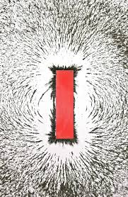
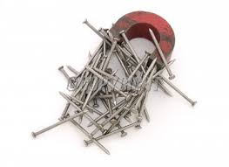
Common Misconceptions about Magnetism
All metals are attracted to a magnet
This is misconception is wrong because metals such as aluminum, tin, and lead are not magnetic. This is because metals such as iron, nickel, and cobalt have their protons and electrons aligned in the same direction. So whenever a bigger magnet passes nearby, the alignment of those protons and electrons shift accordingly to the bigger magnets magnetic field. It is for this reason that non-magnetic metals are not magnetic.

Slide 9
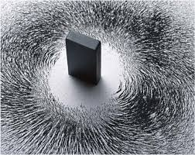
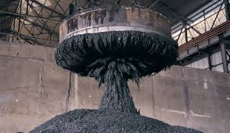
Common Misconceptions about Magnetism
Are larger magnets are stronger than smaller magnets?
No, not all larger magnets are stronger than smaller magnets. For example, super magnets are extremely strong, even a smaller super magnet has a stronger pull than a much larger common magnet. Also, an electromagnet may be stronger than a regular magnet that’s the same size. If the magnets are the same, and are different sizes, the bigger one, however, will be stronger, But if they are made up of different materials, or a different magnet overall, then there is a possibility that the smaller one may be stronger than the bigger one.

Slide 10
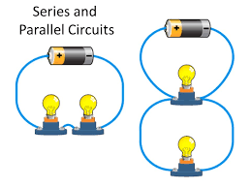
Common Misconceptions about Circuits
There is only one type of circuit
This is not true, since there two types of circuits, arranged differently. One of them is called a series circuit. If we use an led light as an example, several led lights are getting energy through the same wire, which could potentially cause smaller amount of energy for each led. The other is called a parallel circuit. One of the lights first receive current from the battery, which does not decrease the current it’s receiving, and then the other light gets the same amount of current. This type of circuit maximizes the current.

Slide 11
Common Misconceptions about Circuits
A closed circuit will always work
This is not true, since a circuit can be a closed loop and have no current flowing through. For example, if a battery of the circuit that’s providing the energy is dead, no current will be flowing through but it will still be a closed circuit.

Slide 12
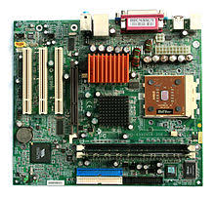
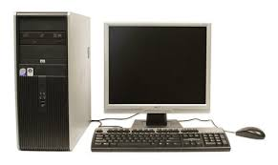
Common Misconceptions about Circuits
Circuits have no every-day use
Thinking about it, we don’t really see circuits directly every day, but that doesn’t mean we don’t use them. Actually, circuits are used everywhere. Circuits are needed in order transfer current through anything, so everything that uses electricity has some sort of a circuit. Your computer, phone, light bulbs and everything else!

Slide 13
Random Facts
About Magnetism
A magnet always has two poles, a north and a south pole
Opposites attract, and the same type of pole repel
The inverse square law applies here too
The magnetic force is inversely proportional to the distance squared, which means as you get farther away, the force weakens

Slide 14
Random Facts About Circuits
Ampere is the unit of measuring electric current.
In a circuit, electrons flow from negative to positive.
A battery consists of one or more section or cells. In every section, two electrodes are separated by a liquid or paste which is called electrolyte.

Slide 15
Bibliography
https://www.livescience.com/38059-magnetism.html
file:///home/chronos/u-b054f200a6dcd29c380b8a225ce1499e3546c62e/Downloads/magnets_k-2_unit_guide%20(3).pdf
http://eschooltoday.com/science/electricity/what-is-an-electrical-circuit.html
http://www.physicsclassroom.com/class/circuits/Lesson-4/Two-Types-of-Connections
https://education.jlab.org/qa/permmagnet_04.html
http://www.ucl.ac.uk/EarthSci/people/lidunka/GEOL2014/Geophysics9%20-Magnetism/Useful%20papers/Magnetism.htm
https://science.howstuffworks.com/environmental/energy/circuit3.htm
http://www.physics-and-radio-electronics.com/physics/magnetism/relation-between-electricity-and-magnetism.html
https://sciencing.com/magnets-electricity-related-6368626.html

