Slide 1
Magnetism and Circuit Concepts
Eric Lindstrom, Helen Fenske, Atena Jabalameli, Phoebe Daruthayan, Hank Johnstone, and Andrew Ignatian

Slide 2
Concepts

Slide 3
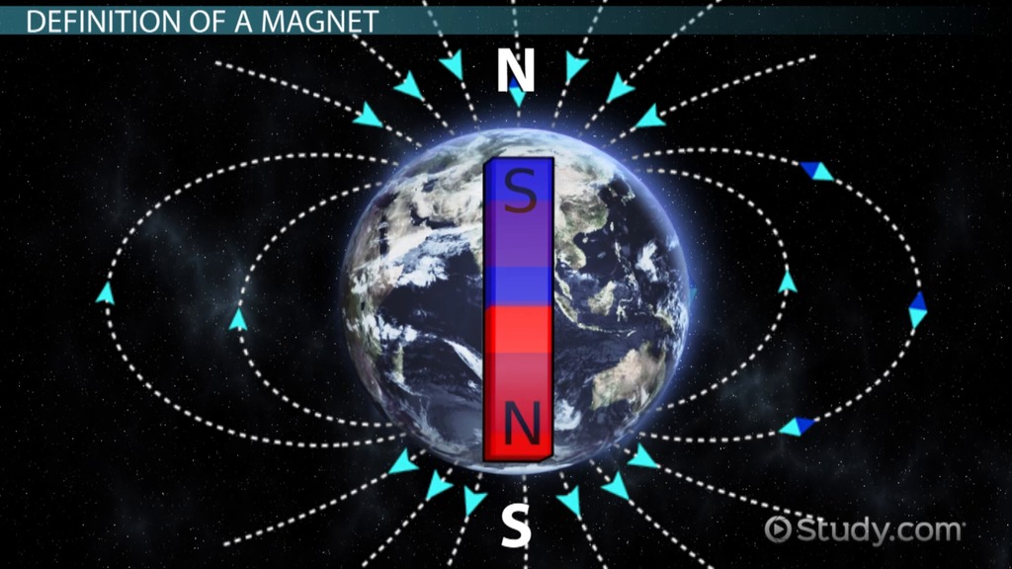
What is magnetism?
Magnetism is a physical phenomenon produced when there is motion in electric charge, thus creating attractive and repulsive forces between different objects
A magnet has two ends called poles, the north pole and the other is called a south pole.
The north pole of a magnet attracts the south pole of another magnet and the south pole of a magnet attracts the north pole of another magnet, while two north pole magnets or two south pole magnets repel each other.
Permanent magnets such as Iron or a pole experience the strongest magnetic effects.
Magnetic fields are in the area surrounding magnets, and are caused by the moving current of electricity through a magnet.

Slide 4
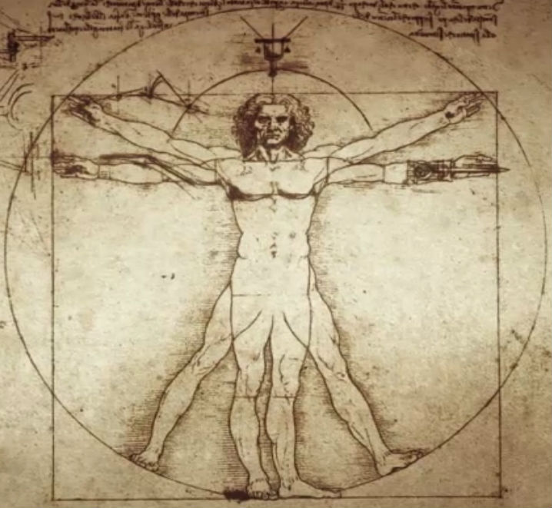
Does it have an effect on people?
People don’t feel magnetism acting on them
Human beings might have a sense of direction based on the earth's magnetism, almost like they have internal compasses
Magnets such as iron experienced the strongest effects, known as ferromagnetism, which is the only form of magnetism that is strong enough to be felt by people.
But there can be small effect on someone's vision or heart when under magnetism.
Studies show that it could be possible for living things to see magnetic waves when put in the correct conditions.

Slide 5
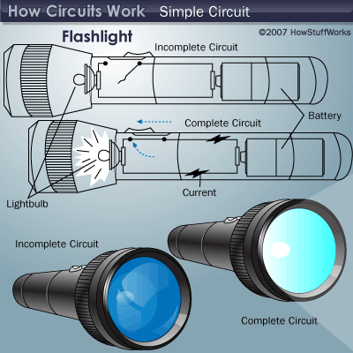
Circuits - How do they work?
Circuits are similar to our circulatory system
When a circuit is complete the electricity flows in a complete path
When a switch is pressed it closes the circuit giving the electricity a complete path to flow through
When a circuit is closed electrons can flow through indefinitely
Georg Simon Ohm founded the law (Ohm’s Law) that a current is proportional to the difference in electric energy applied to the ends of the wire
Ohm also said that everything electronic offers resistance to the flow of energy

Slide 6
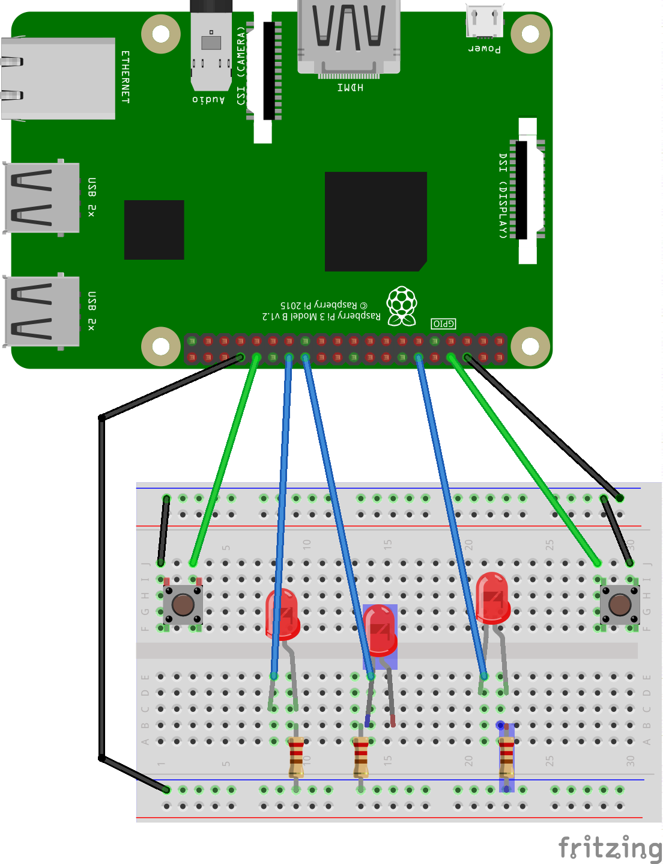
What makes circuits function?
An electric circuit is like a pathway, made of wires, that electrons can flow through.
A battery or another power source gives the force (voltage) that makes the electrons move.
When the electrons get to a device like a light bulb, or your computer, they give it the power to make it work.
The battery gives the circuit a source of energy.
The switch makes it to open or close the electrical circuit, turning the flow of electricity on or off.
The light bulb is used to tell whether the electricity is flowing or not.

Slide 7
Important Formulas
Ohm’s law- V = IR (voltage equals current multiplied by resistance)
Voltage- V= I x R ( voltage is equal to current times the resistance)
Resistance- R= V/I (Resistance is equal to the voltage divided by current)
Magnetic Force & Inverse Square Law: F_{B} ∝ 1/R²; the magnetic force is inversely proportional to the distance squared
Electric current- I = ∆Q/∆t (current equals charge divided by time)
Ampere’s Law: B ∝I/r; the strength of the magnetic field is directly proportional to the current inversely proportional to the distance from the wire.

Slide 8
Misconceptions

Slide 9
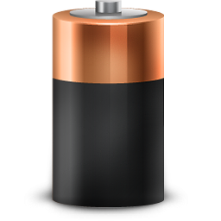
A battery does not create power, it only makes electrons move
The cathode and anode (the positive and negative sides at either end of a traditional battery) are hooked up to an electrical circuit. The chemical reactions in the battery causes a buildup of electrons at the anode.

Slide 10
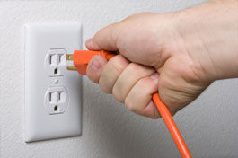
Electricity does not react instantly, but it moves very quickly
Although electricity seems to move instantly, it does take some time for the current to pass through the circuit
This time is still somewhat quick but is not instant

Slide 11
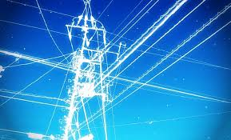
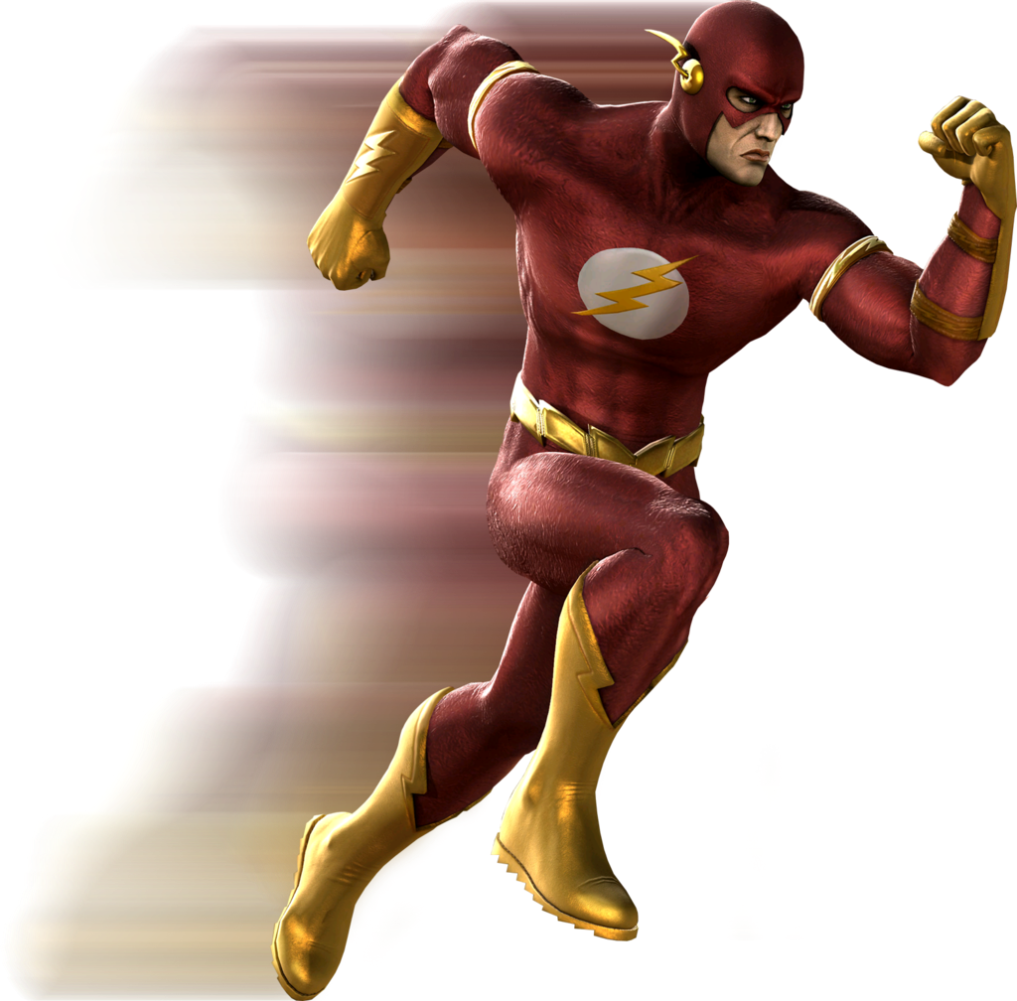
Electricity does not move at the speed of light
While traveling through wires electricity doesn’t travel at the speed of light
Electricity moves at 1/100 of the speed of light

Slide 12
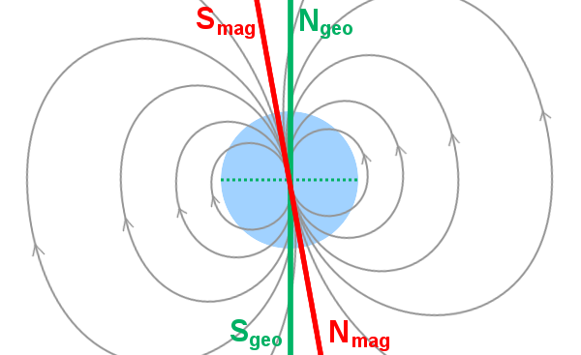
The geographical North Pole is not always the same as the magnetic North Pole
The magnetic North Pole is constantly changing
This is because surrounding the inner iron core of the earth is a layer of hot liquid metal
This liquid metal creates Earth’s magnetic field and since the liquid can move, so can the magnetic North Pole

Slide 13
Not all metals are attracted to metals.
Whether an object is magnetic or not depends on the alignment of magnetic domains
Whether the domains line up or not is a result of solids and forces

Slide 14
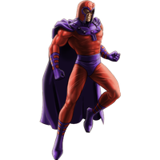
Because a magnet is bigger, it does not always make it stronger.
Different materials have different amounts of strength
Some electromagnets are also very strong for their size

Slide 15
Kahoot !!!!
https://play.kahoot.it/#/?quizId=12981a65-25fe-4499-b830-e3c7b700371e

Slide 16
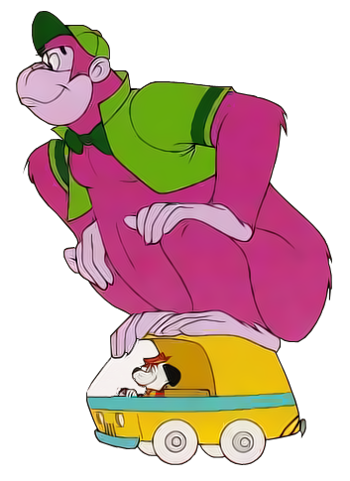
Work Cited
http://www.nytimes.com/1983/02/22/science/do-enormous-magnets-affect-the-human-body.html
http://discoverykids.com/articles/how-do-electric-circuits-work/
https://www.livescience.com/38059-magnetism.html
http://www.explainthatstuff.com/magnetism.html
https://www.enotes.com/homework-help/what-function-battery-switch-light-bulb-wires-162635
http://www.electronics-tutorials.ws/dccircuits/dcp_2.html

