Slide 1
Magnetism and Circuits
By Sam Salit, Sydney Wang, Lauren Hong, Sofie Daley, Dariya Paull, Danielle Wilson

Slide 2
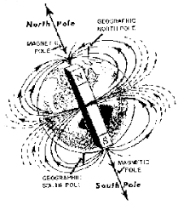
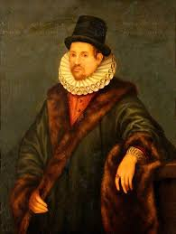
William Gilbert
Discovered Earth itself was a magnet with a North Pole in the Arctic and the South Pole in Antarctica

Slide 3
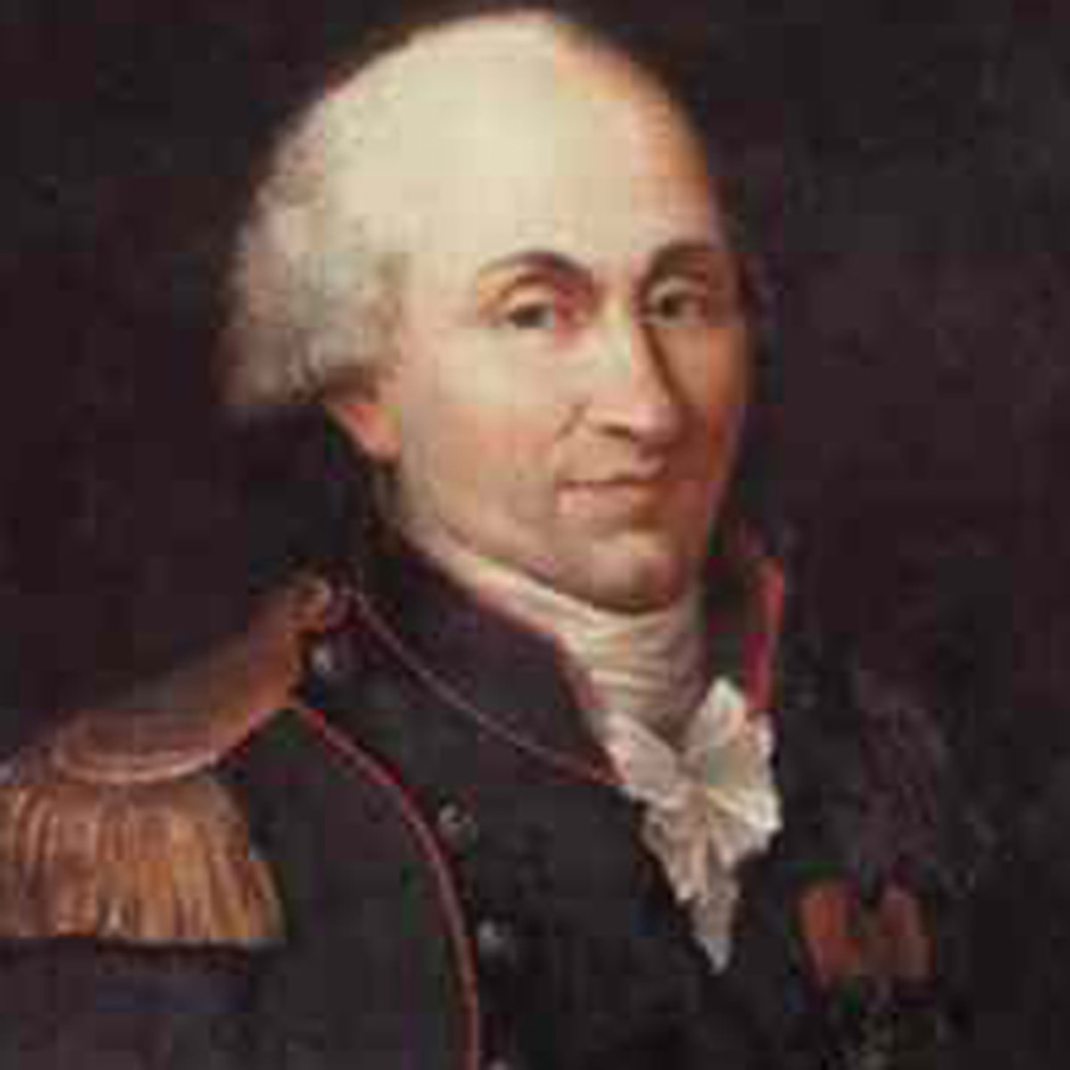
Charles- Augustin de Coulomb
Coulomb’s law: The magnitude of the electrostatic force of attraction or repulsion between two point charges is directly proportional to the product of the magnitudes of charges and inversely proportional to the square of the distance between them.

Slide 4
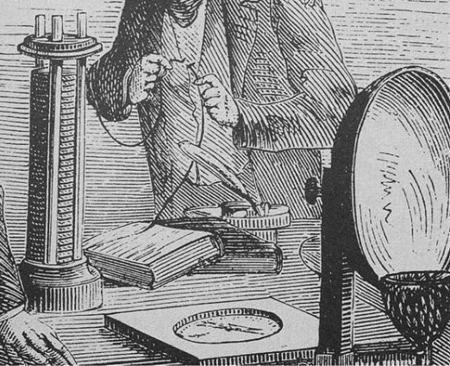
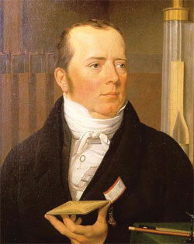
Han Christian Oersted
Found that electricity and magnetism are connected
Discovered a magnetic field is produced by the motion of an electric charge

Slide 5
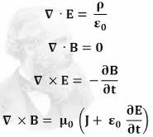
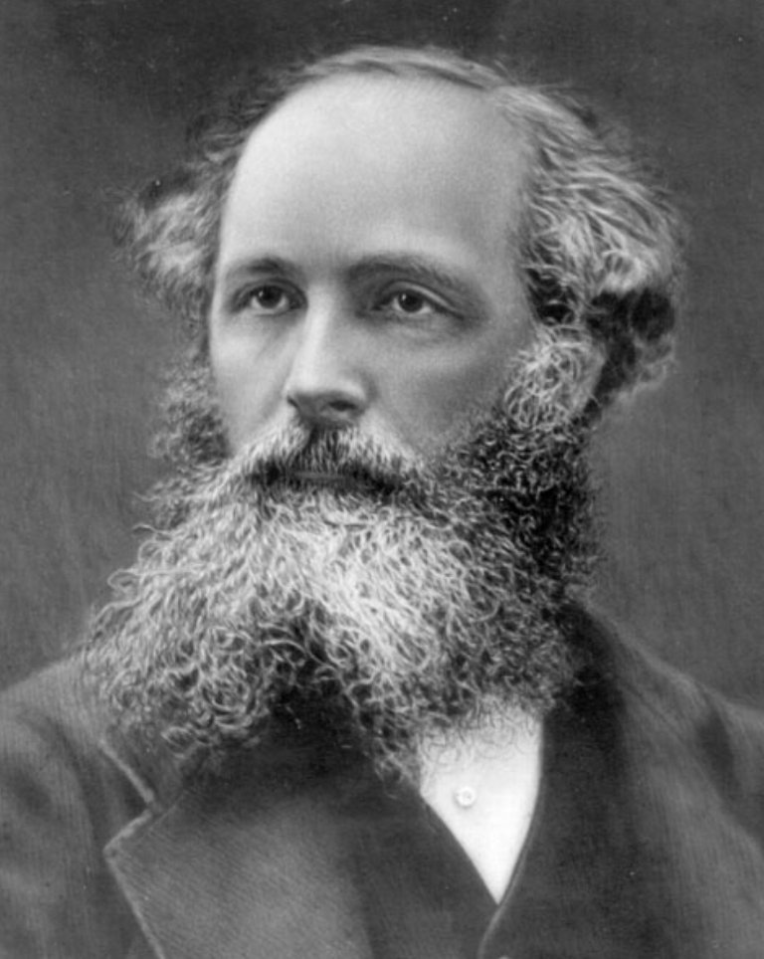
James Clerk Maxwell
Put together all of the different laws to make four fundamental truths

Slide 6
The electric field leaving a volume is proportional to the charge inside (Gauss’ law)

Slide 7
2. There are no magnetic monopoles (have to always have a north and south pole) (Gauss’ law for Magnetism)

Slide 8
3. The voltage in a closed loop is proportional to the rate of change of the magnetic field the loop it is exposed to (Faraday's law)

Slide 9
4. The magnetic field around a closed loop is proportional to the electric current added to the electric field’s rate of change. (Ampere’s Law)

Slide 10
Magnet facts
-All magnets have 2 poles that cannot be isolated: North and South
- Will always align with these poles because of Earth’s magnetic field
-Like poles repel and opposite poles attract

Slide 11
Pole
A point of strongest magnetic effect

Slide 12
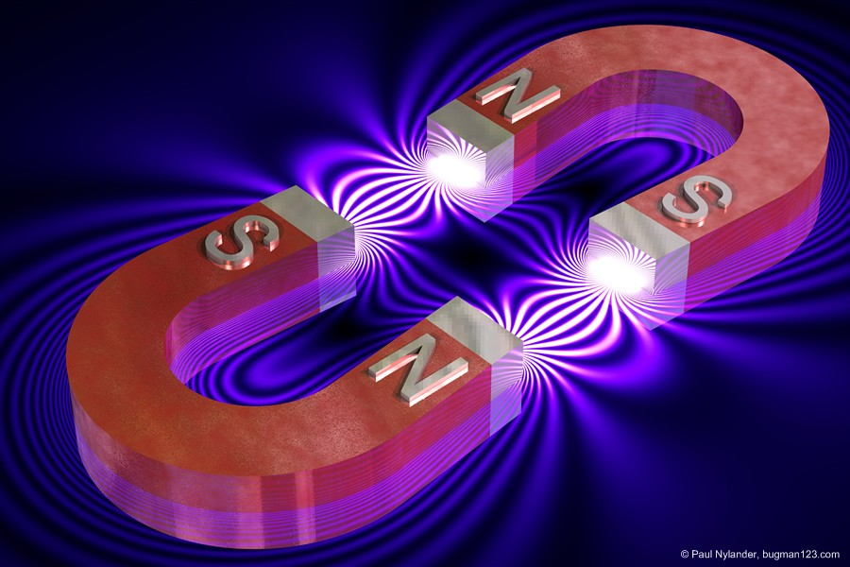
Magnetism
Light is a wave of electromagnetism
An electric current produces an electric field
The force from a magnetic field is perpendicular to the magnetic field and the current
Currents are made up of moving electric charges (electrons)
magnetic field also exerts a force on single electric charges that pass through it

Slide 13
Domain
The magnetic field of individual atoms in which the magnetization is in a unified and aligned direction

Slide 14
Domains
Non magnetic material (no domains)
More domains there are = stronger magnetic forces
Found mainly in metals
Alignment of domains creates magnetism
heat/ friction change alignment
magnetic material (domains, not lined)
Magnet (lined up domains)

Slide 15
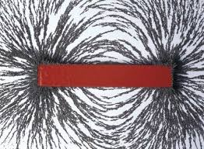
Magnetic Fields
-All fields have some charge in motion - spinning electrons create magnetism (magnetic fields)
-Electric field produced by changing magnetic field
-Field opposed the original magnets which created it
-Laws:
Field lines point from north to south (direction of a compass)
Field lines never cross
Density of field lies is proportional to the strength of the field

Slide 16
F
I
L
B
sin0
Magnitude of the Force
Current
Length
Magnetic Field
Angle between Current and the Magnetic Field
Magnitude of the force from a magnetic field

Slide 17
FB∝1/r²
The magnetic force is proportional to one over the distance squared.
Common mistake: forgetting that the distance is squared. Don't forget to rewrite the equation with it that that that they are INVERSELY proportional

Slide 18
B∝I/r
The magnetic field is proportional to the current over the distance
Common mistake: forgetting what each of the letters mean and the units. To solve this problem, make flashcards and memorize what units go with what and what the letters symbolize.

Slide 19
Circuits

Slide 20
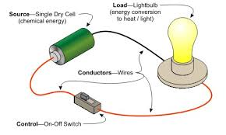
What is a Circuit?
A circuit is a closed loop that allows electric current or electrons to flow through.
The requirements for a circuit:
Closed loop
A power source (something to push the electrons [i.e. battery])
Conductors (something that the electrons can pass through [i.e. wires])
Load (something to use up the energy created [i.e. light bulb])
Control (something to close and open the loop [i.e. on-off switch])
Circuits can be used to power things like bulbs or other electrical components
Most circuits are battery powered, batteries are the main source of energy and helps electrons flow
Electrons flow negative to positive
If there is a gap in the current, the circuit will not flow

Slide 21
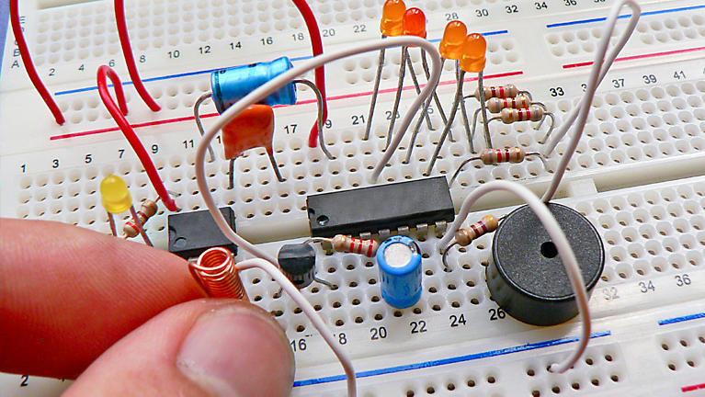
Circuit Misconceptions
Circuits DO:
Move electrons
Generate current
Move negatively charged electrons through wire
Contain free electrons
Circuits DON’T:
Make electrons
Build charge
Gain charge
Reduce charge
Have charges flow through at high speeds through them

Slide 22
Electric current
The flow of electric charge

Slide 23
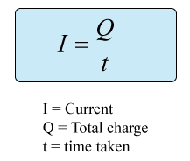
Electric Current
Electric current is the flow of electric charge.
It is measured in amperes
It is carried through a conductor
Electric current is how much charge passes through in a certain amount of time or
This formula helps find how much current is flowing in a circuit

Slide 24
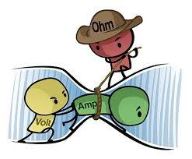
Ohm’s Law and Resistance
V=IR, The potential difference (voltage) across an ideal conductor is proportional to the current through it.
(Where R = resistance, I = current, and V = voltage)
(measured in ohms Ω)
All electronic devices offer resistance to the flow of current.

Slide 25
Circuit Facts
An electrical circuit is a closed loop that electrons can be pushed through to create electricity.
It is a circuit if it has:
A closed loop
A power source
A conductor
A load
A control
I=Q/t is the formula used to calculate how much current is flowing through a circuit

Slide 26
Any questions?

Slide 27
Questions:
Answers:
For 10 minutes, a current of 45 amps flows through a circuit. How much charge passes through the circuit?
A drone uses 2 amps from a 7 volt battery. What is the resistance?
If the magnetic field is quadruples, what happens to the current?
I = q/t ; 27,000 c
V= IR; 4.5 Ω
It also quadruples

Slide 28
Did you guys pay attention? Let’s find out with a KAHOOT!

