Slide 1
Linear Motion
By: Arianna de la Torre Roehl, Alyssa Miyamoto, Angeli Paull, Haiden Nelson, Karlyn Bortfeld, Nathan Cook

Slide 2
Linear Motion is motion that occurs in a straight line.

Slide 3
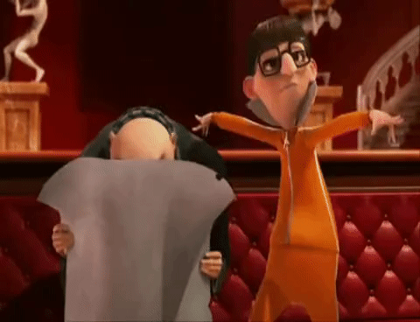
Vocabulary
Vector - a quantity with both magnitude and direction
Scalar- a quantity with only magnitude
Independent Variable- x-axis value
Dependent Variable- y-axis value
Frame of Reference - describes the point of reference to which an object is moving compared to another
Velocity- speed in a given direction
Acceleration- the change in velocity per unit of time

Slide 4
Reference
30 m/s
Motion is described and perceived differently based on the different frames of reference.
Relative to the moving car, the pink man is not moving.
Relative to the red man, the pink man is going 30 m/s.

Slide 5
Reference Common Misconception
The pink man might not appear to be moving.
We are never truly motionless, even if we are standing still. It all depends on our reference point. If we look from the sun, we are revolving around earth, will the earth orbits the sun.
But the earth is always turning, and the man is turning with it.

Slide 6
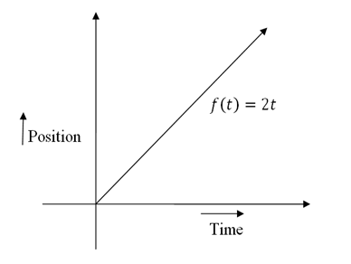
Slope
Slope - number that describes both the direction and steepness of a line
Positive - indicates forward direction
Negative - indicates backwards direction
None - indicates no motion
In position vs time graph, it represents velocity
In velocity vs time graph, it represents acceleration

Slide 7
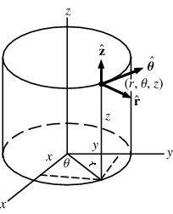
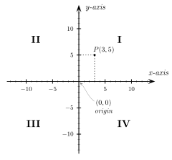
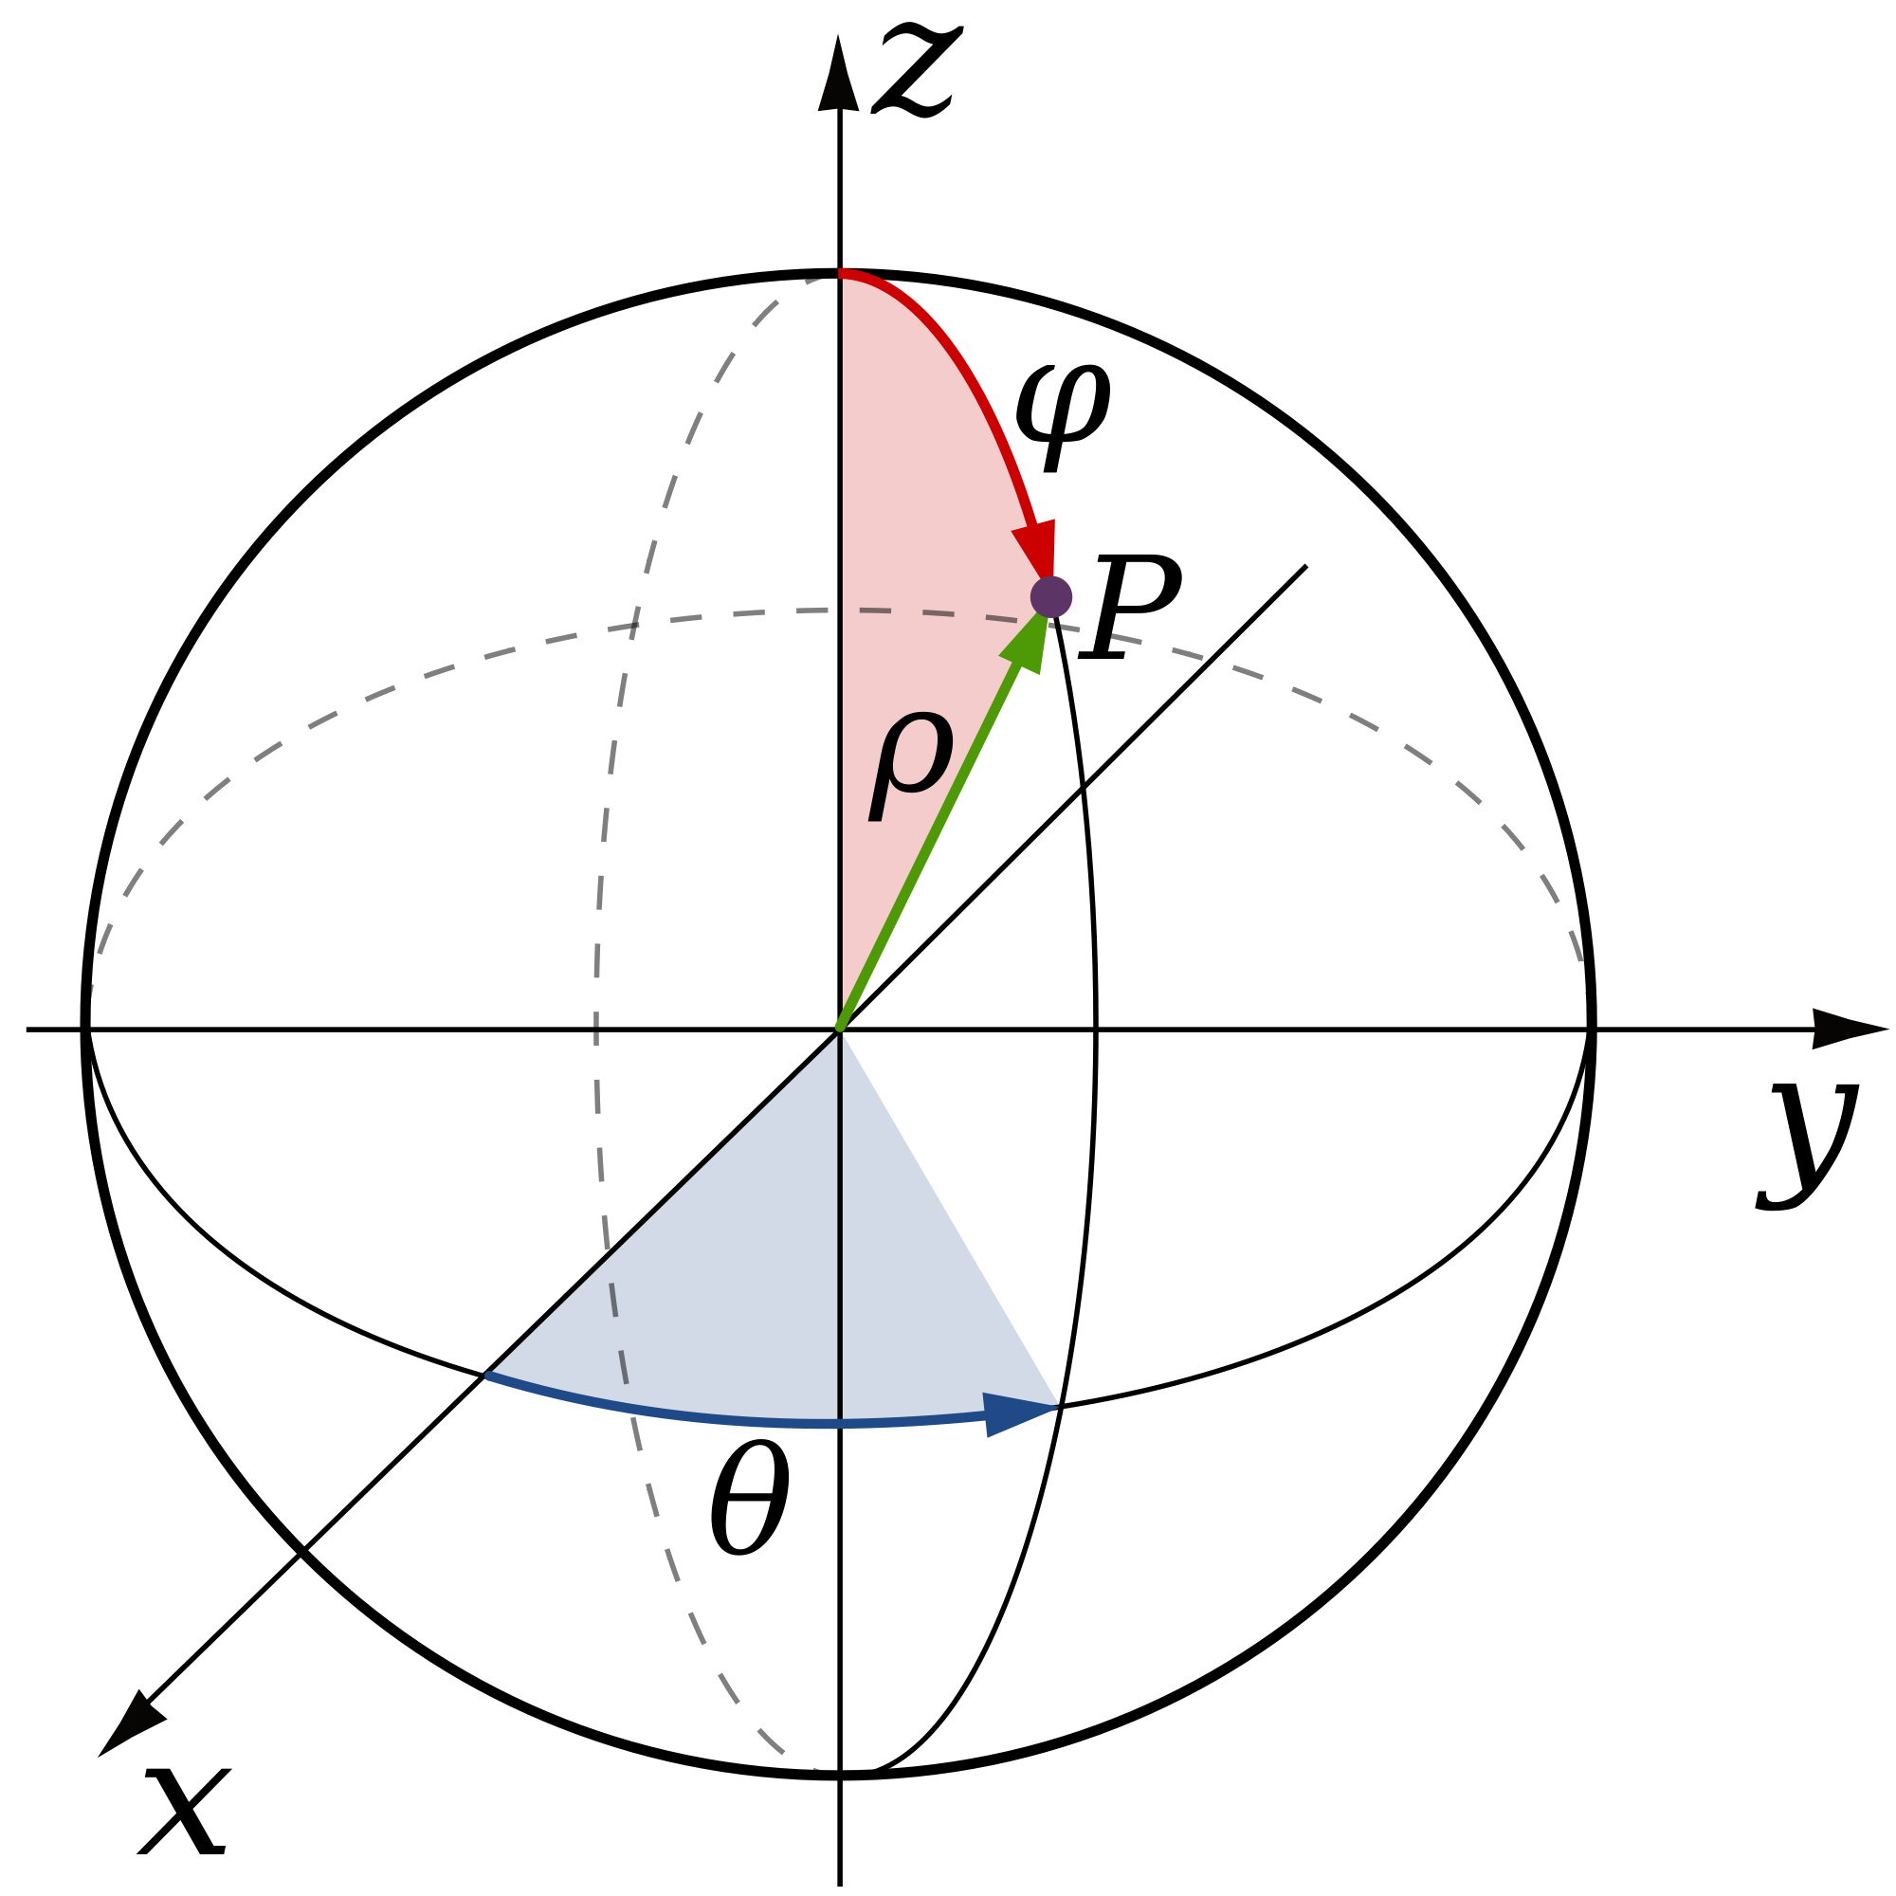
Ways to Describe Location
Spherical Coordinates
Cartesian Coordinates
Cylindrical Coordinates

Slide 8
Formulas
v=dx/dt
Velocity= rate at which position changes with time
Change in x over change in time

Slide 9
Practice
Find the velocities of segments AB, BC, and CD.
Distance (meters)
B
C
A
D
Time (sec)

Slide 10
Practice
AB= 1 m/s
BC= 0 m/s
CD= -1 m/s
Common Mistakes:
-When it is a straight line, it has no slope and a velocity of ZERO
- Slope is the change in distance over the change in time. So, you must divide the change in the y-axis by the change in the x-axis.
Distance (meters)
B
C
D
A
Time (sec)

Slide 11
Formulas
𝚫x=∫v•dt
Change in position = velocity integrated over time
Used to find the area under the graph
Tells the distance traveled

Slide 12
Example: What is the total distance traveled after 12 seconds? (HINT: Use the formula 𝚫x=∫v•dt )
Velocity
Velocity
9
5
0
2
4
6
8
10
12
0
4
8
12
Time (Seconds)
Time (Seconds)

Slide 13
Solution:
Velocity
9
Velocity
5
0
0
12
12
Time (Seconds)
Time (Seconds)
Solution: 54m (½ 9*12)
When fining the total distance, you need to find the AREA below the graph. For a triangle, the area is 1/2bh.
Solution: 60m (5 * 12)
When fining the total distance, you need to find the AREA below the graph.

Slide 14
Formulas
a=dv/dt
Acceleration = rate at which velocity changes with time
Change in v over change in time

Slide 15
Examples
A car starts at rest and accelerates over a time of 6 seconds at a velocity of 36 m/s. What is the acceleration of the car?
Notes:
3.3 m/s/s

Slide 16
Formulas
𝚫x=vf²/2a
Change in position = final velocity squared over two times acceleration
Change in v over change in time

Slide 17
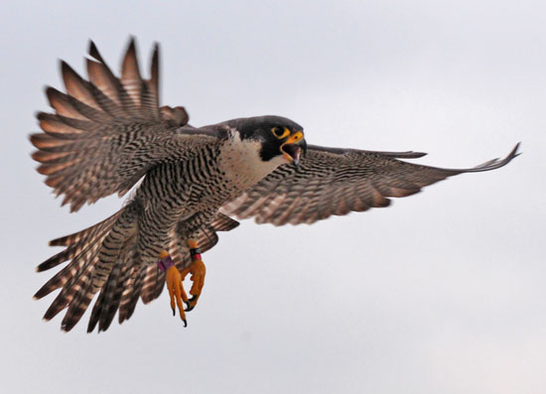
Examples
A peregrine falcon flies at 110 m/s. Find the total distance traveled of the falcon if it accelerates at 5 m/s².

Slide 18
Solutions
Problem:
A peregrine falcon flies at 110 m/s. Find the total distance traveled of the falcon if it accelerates at 5 m/s².
110
90
70
50
30
10
Acceleration = 5 m/s²
Velocity (m/s)
𝚫x=vf²/2a
𝚫x=(110m/s)²/2(5m/s²)
𝚫x=12100m²/s²/10m/s²
𝚫x=1210 m
0
Time (s)

Slide 19
Formulas
𝚫x=½ a𝚫t²
Change in position = one half of the acceleration times the change in time squared
This is often used to find the the time

Slide 20
Example
A car travels at an acceleration of 3 m/s². From rest, how long will it take for the car to travel 60 meters? (HINT: Use the formula 𝚫x=½ a𝚫t² )

Slide 21
Solution
Solution: 6.3 seconds
𝚫x=½ a𝚫t²
60 = ½ (3)𝚫t²
60 = 1.5 𝚫t²
40= 𝚫t²
√40 = √𝚫t²
𝚫t= 6.32455532034
𝚫t≈ 6.3 seconds

Slide 22
Common Mistakes
Some think that if an object has speed, it is accelerating
If speed is constant, there is no acceleration. Acceleration, a vector, can only occur by increasing/decreasing speed or changing direction
Some think that negative acceleration means the object is going at a slower rate
A negative sign signifies direction, meaning that it is going the opposite way
Many think that speed and velocity are the same thing
Speed is a scalar while velocity is a vector, therefore velocity requires a speed in a given direction.
Some think that if the instantaneous acceleration is 0, the instantaneous velocity is 0
Acceleration requires a change in speed. Therefore, as long as the object is moving at a constant rate in a straight line, the acceleration will be 0.

