Slide 1
Linear Motion
Act II, Scene I-II
By: Melissa Le, Kai Monn, Ryan Morgan, Ava Gabriel, Cailey McLurkin, Isaac Beliz

Slide 2
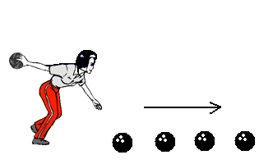
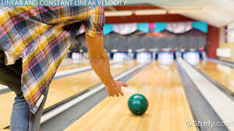
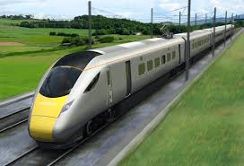
Linear
Motion
In Life
Notes:
The mass and shape of an object does not affect the motion. And with whatever
factors of time, velocity, and distance the object will always have an acceleration
of 9.8m/s falling. If the acceleration is constant, the velocity increases linearly(like shown in the graph).
But linear motion can be shown in many ways, differing from size, direction, and
location. But that direction would have to be going in a straight line. There are many
examples of linear motion. From a bullet flying to a bowling ball being rolled. From a
race to a marching band marching. From a swimmer to a train moving on a track. These
are all some of the many examples of linear motion in life.

Slide 3
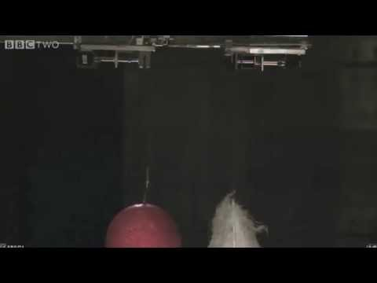
Notes:
These two objects are in a vacuum chamber. There is not air in a vacuum chamber. Since there is no air, there is no air resistance. Because of this, all objects fall at the same rate. It does not depend on their weight or their size or shape, everything in the vacuum chamber will fall at the same rate. This rate is 9.8 meters per second.

Slide 4
Linear motion...
Can be described with equation distance over time
Is the most basic of all motion.
Has two types:uniform linear motion w/ a constant velocity and non uniform linear motion w/ variable velocity
Has a continuous rate of change throughout all of the data
The distance traveled can be found with the equation d = VΔt
The velocity can be found with the equation V = Δd/Δt

Slide 5
Common mistakes and how to avoid them
Linear motion vs. rotational motion: The difference is that rotational motion has an object moving around the x-axis so it is three dimensional. Whereas linear motion is an object's movement in a straight consistent line which makes it two dimensional. So linear motion is more of an “A to B” and rotational motion a circular motion.
What lands first?: Another misconception about linear motion is that if an object is heavier, it will land first. This however is not true, if you neglect air resistance both objects will both fall at the rate of around 9.8 m/s.
Acceleration: Acceleration can be a linear motion if it is consistent, however, if the rate of acceleration is increasing, it becomes a nonlinear motion.

Slide 6
Common mistakes and how to avoid them
Velocity: A common misconception about velocity is that it can only be positive however it can be a negative motion as well. If an object is thrown in the opposite direction of its initial direction, it would be a negative velocity.
Velocity/Acceleration: You should also be taking into account that both acceleration and velocity are both vectors. This means that both magnitude and direction are relevant variables in the data.
Scalar/Vector:Vectors consider both magnitude and direction as relevant variables in the data whereas a scalar consists of just magnitude.

Slide 7
Work Cited
Hall, Nancy. “Motion of Free Falling Object.” NASA, NASA, 5 May 2015, www.grc.nasa.gov/www/k-12/airplane/mofall.html.
The Editors of Encyclopædia Britannica. “Linear Motion.” Encyclopædia Britannica, Encyclopædia Britannica, Inc., 23 June 2017, www.britannica.com/science/linear-
Types of Motion | a2-Level-Level-Revision, Pe-Physical-Education, Motion-and-Mechanics, Types-Motion | Revision World, Www.revisionworld.com/a2-level-level-revision/pe-physical-education/motion-and-mechanics/types-motion.

Slide 8
Kahoot
https://play.kahoot.it/#/?quizId=ef0dd161-b8c7-411a-b73e-5334db9c8557

