Slide 1
Linear Motion
By: Maggie, Allison, Abraham, Luke, Katie, and Devyn

Slide 2
What is Linear Motion?
Linear Motion is a motion of a particle or object moving from one point to another. It:
travels in a straight line
takes place in one spatial dimensional
is one dimensional
is sometimes referred to as “uniform linear motion” or “rectilinear motion”
has a unchanging velocity
is the opposite of “nonlinear motion”
is referred to as a “translation” when all parts of the object move the same distance

Slide 3
Significance of Linear Motion
Newton’s first law , “An object at rest stays at rest and an object in motion stays in motion with the same speed and in the same direction unless acted upon by an outside unbalanced force” deals with the concept of linear motion. No matter which direction an object is going, if it is moving, it will continue in the same direction if there is no force to change it, which is the concept of linear motion.

Slide 4
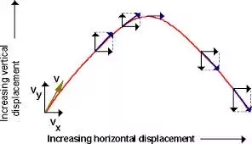
Misconception #1
A ball cannot land back in your hand if you throw it while moving because it will go straight up.
If you are walking when you throw the ball and it is in your hand, it will have the same velocity as you do. When you throw it, it is moving up, but also forward to to that horizontal velocity of your walking. So if you keep walking at the same speed, the ball will land in your hand.
This only works if you are moving at a constant velocity. If you start walking after you throw the ball it will end up behind you because at the time the ball was thrown the velocity of you and the ball was 0.

Slide 5
Misconception #2
Velocity and acceleration must be in the same direction.
If the velocity and acceleration are in the same direction, and both have the same sign, the object is speeding up.
If the velocity and acceleration are in opposite directions with opposite signs, the object is slowing down.

Slide 6
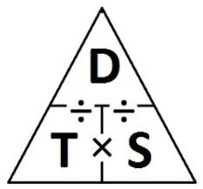
Misconception #3
-- Keeping the same position means you keep the same speed.
This means that for you to change your position you need to move a certain amount of distance from your fixed point.
So since speed is described as distance over time, if you haven’t traveled any amount of distance there is no difference in speed.

Slide 7
Misconception #4
Velocity must be positive.
When an object has a negative velocity, it is just traveling to the left
This is because of negative signs in physics only meaning direction
For a velocity to be positive, the object has to be moving to the right, but for an object to have a negative velocity, the object has to be moving to the left

Slide 8
Misconception #5
Objects at rest cannot be accelerating.
Acceleration is a change in velocity
Object could be at rest for a very small amount of time but later pick up speed
Can be changing velocity even while object is at rest
If an object is thrown into the air, when it is at the highest point and no longer going up, it is only changing its direction, thus making it still accelerating.

Slide 9
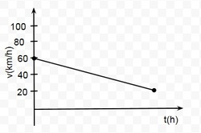
Misconception #6
-- The difference between the slope and the height on a velocity-time graph
On a velocity-time graph the slope is the acceleration (m/s²) and the height of the graph is the velocity (m/s).
Velocity is known as the rate at which an object changes position.
Acceleration is the rate of change of velocity per unit of time or the change in velocity

Slide 10
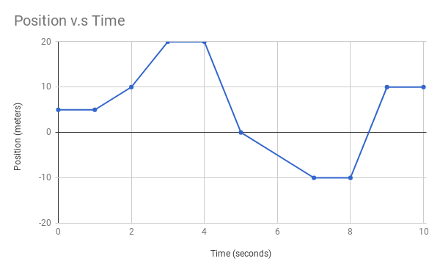
Example Problem #1
For the following position v.s time graph, determine the velocity at 5 seconds. (the first negative slope)
Notes:
EXPLAIN HOW TO GET ANSWERS USING SPECIFIC FORMULA : VELOCITY EQUATION
V_{AB} = 0 m/s; V_{BC} = 5 m/s; V_{CD} = 10 m/s; V_{DE} = 0 m/s; V_{EF} = -20 m/s; V_{FG} = -10 m/s; V_{GH} = 0 m/s; V_{HI} = 20 m/s; V_{IJ} = 0 m/s

Slide 11
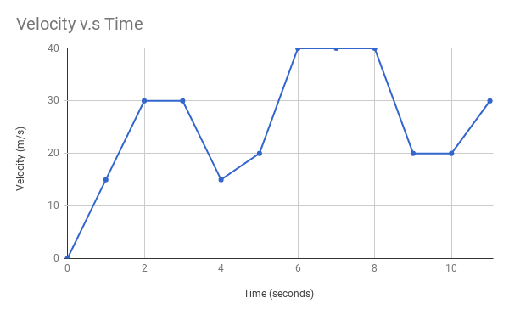
Example Problem #2
For the following velocity v.s time graph, determine how far you traveled over time in the first 2 seconds.
Notes:
MENTION HOW SPECIFIC FORMULA IS USED : DISTANCE EQUATION
dx_{0~2} = 30 m; dx_{2~3} = 30 m; dx_{3~4} = 22.5 m; dx_{4~5} = 17.5 m; dx_{5~6} = 30 m; dx_{6~8} = 80 m; dx_{8~9} = 30 m; dx_{9~10} = 20 m; dx_{10~11} = 25
dx_{total} = 285 m

Slide 12
Example Problem #3
For the following velocity v.s time graph, find the accelerations for 6-8 seconds.
Notes:
MENTION HOW SPECIFIC FORMULA IS USED : ACCELERATION EQUATION
a_{0~2} = 15 m/s; a_{2~3} = 0 m/s; a_{3~4} = -15 m/s; a_{4~5} = 5 m/s; a_{5~6} = 20 m/s; a_{6~8} = 0 m/s; a_{8~9} = -20 m/s; a_{9~10} = 0 m/s; a_{10~11} = 10 m/s

Slide 13
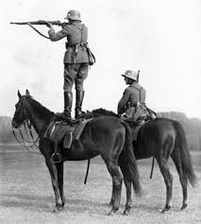
Example Problem #4
If a soldier is riding on a horse that is going 15 m/s and fires a bullet traveling 95 m/s, how fast would the bullet be traveling relative to the ground?
110 m/s
100 m/s
>9000 m/s
1 m/s
Notes:
Galilean Relativity - different perspectives may differentiate the speeds
110 m/s

Slide 14
Example Problem #5
Turbo, the snail, is about to pull his greatest stunt, jumping off a 20 m boulder. For his first run, Turbo gets about 4 seconds of airtime before landing about 50 m from the base of the boulder.
If he goes again, going three times his original speed, then:
about how far from the base of the cliff do we expect him to land?
about how much time do we expect him to be in air?
200 m; 9 sec
150 m; 8 sec
150 m; 4 sec
200 m; 4 sec
Notes:
Projectile Motion: the horizontal and vertical components of projectile motion are completely independant of each other
150 m
4 seconds

Slide 15
Works Cited
The Editors of Encyclopædia Britannica. “Linear Motion.” Encyclopædia Britannica, Encyclopædia Britannica, Inc., 23 June 2017, www.britannica.com/science/linear-motion.
Burkett, Brendan. “Basic Principles for Understanding Sport Mechanics.” Human Kinetics, 2010, www.humankinetics.com/excerpts/excerpts/basic-mechanical-principles.
“Linear Motion - Physics Video by Brightstorm.” Brightstorm, www.brightstorm.com/science/physics/linear-and-projectile-motion/linear-motion/.
Elert, Glenn. “Graphs of Motion.” Graphs of Motion – The Physics Hypertextbook, physics.info/motion-graphs/.

