Slide 1
Gravity Review
By: Josh Fung, Leilani Burke, Logan Wilcox, Kylie Yetenekian, Skyla Park, and Steven Aghakhani

Slide 2
Gravity is a type of force also known as the gravitational force. Gravity usually forces two objects to attract towards each other when they have a nonzero mass.

Slide 3
Gravity Equation
F_{g}=Gm₁m₂ / r²
(the force of gravity is proportional to the product of the masses and inversely proportional to the distance squared)
Used to find the force of gravity in scenarios
Notes:
skyla

Slide 4
F_{c} = MV² / r
Circular Motion Equation
Product of mass & velocity² / radius of circular path

Slide 5
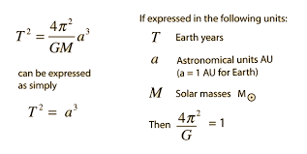

Slide 6
Vocabulary
Scientific Law - predicts what will happen
For example, Newton’s Universal Law of Gravitation explains and predicts how “every point mass attracts every single point mass by a force pointing along the line intersecting both points”
-Scientific Theory - predicts why what happened has occurred
For example, Einstein’s Theory of General Relativity attempts to provide an explanation for why things fall.

Slide 7
Vocabulary (cont.)
Centripetal force- the force that affects the body that orbits in a circular path that is directed towards the center of which the body is moving around
For example, when the earth is being orbited by the moon, the centripetal force is provided by the force of gravity that acts on the moon.
Tangential velocity- the linear velocity/speed of an object moving in a circular motion or path
For example, you could figure out how much distance a planet travels in its orbit during a certain amount of time (in a linear motion versus a circular motion) by calculating the tangential velocity.

Slide 8
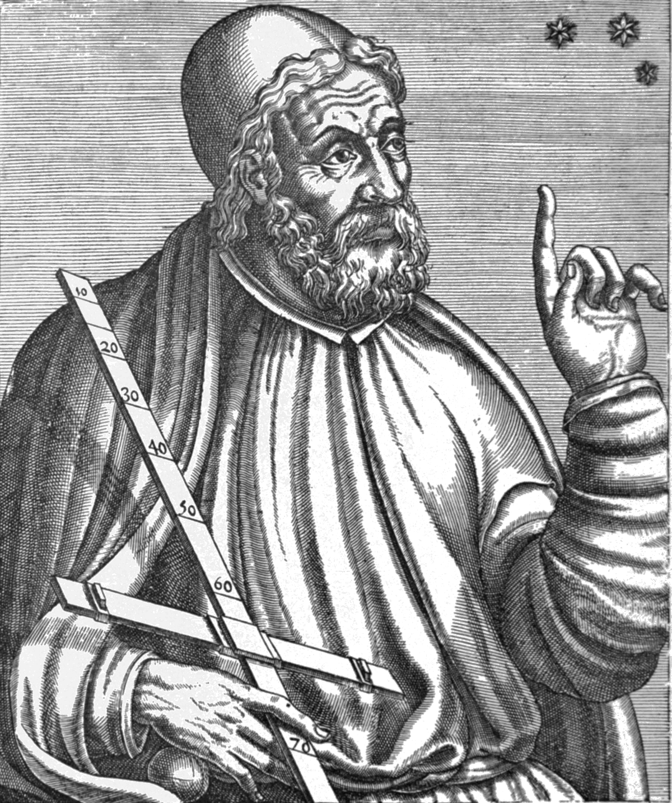
Ptolemy
Geocentric model
Earth was the center of the solar system

Slide 9
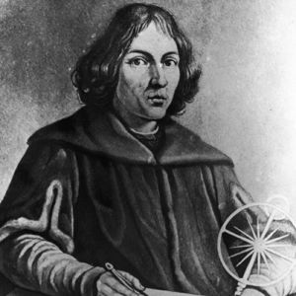
Nicolaus Copernicus
Heliocentric theory
Sun was the center of the solar system
Beginning of the scientific revolution

Slide 10
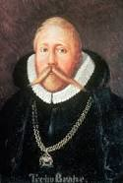
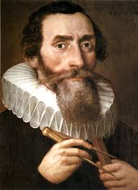
Tycho Brahe
Johannes Kepler
Compared theories to data
World last naked eye astronomer
Tycho Brahe’s assistant
Formed three planetary laws with a telescope

Slide 11
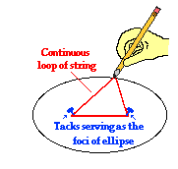
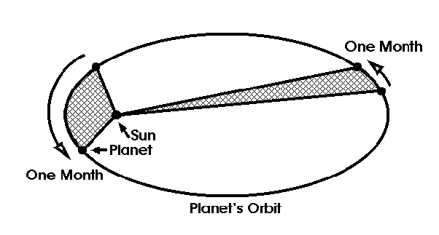
Kepler’s Laws
The Law of Ellipses - An ellipse is a special curve in which the sum of the distances from every point on the curve to two other points is a constant. It has two focus points, known as the FOCI of an ellipse. Kepler’s first law states that all planets orbit the sun in an elliptical shape.
The Law of Equal Areas - The law describes the speed of which any given planet will move while orbiting the sun. The speed varies depending on the location in their orbit. The closer they are, the faster they will move, and as they get farther in their orbit, the slower they will move. This makes it so, if measured using days, the distance traveled in 31 days while farthest from the sun will be the same as closest to the sun.
The Law of Harmonies - The orbital period of a planet, squared, is proportional to its average distance from the sun, cubed. So the further away it is, the slower the orbit.

Slide 12
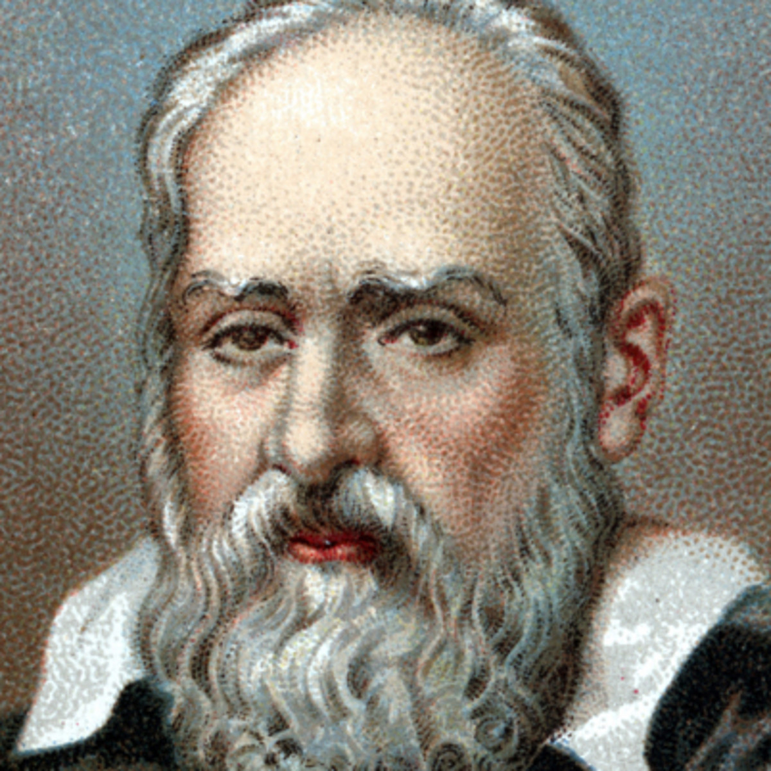
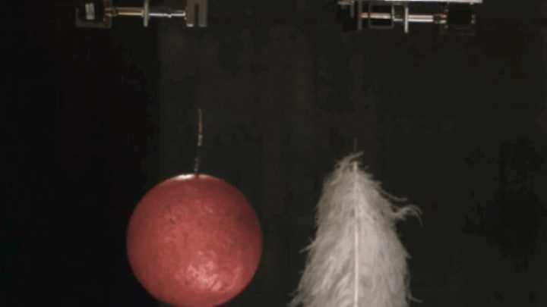
Galileo Galilei
Found that air resistance prohibits objects from being acted upon by gravity
Gravity works on all objects the same
{Bowling ball vs feather}

Slide 13
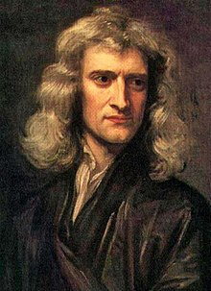
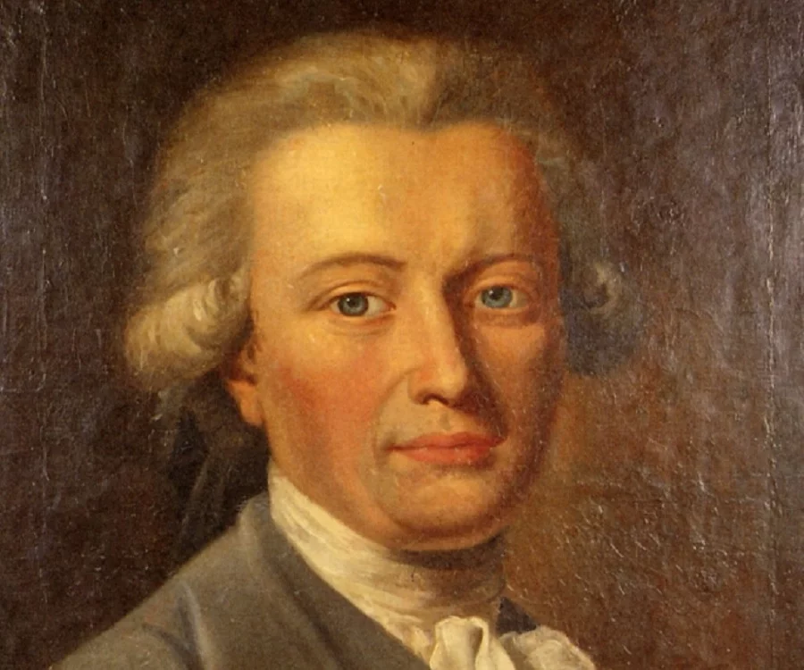
Isaac Newton
Henry Cavendish
Principia
Proved laws formed by others’ before him
The Cavendish experiment - The cavendish experiment
Discovered hydrogen or at the time “inflammable air”

Slide 14
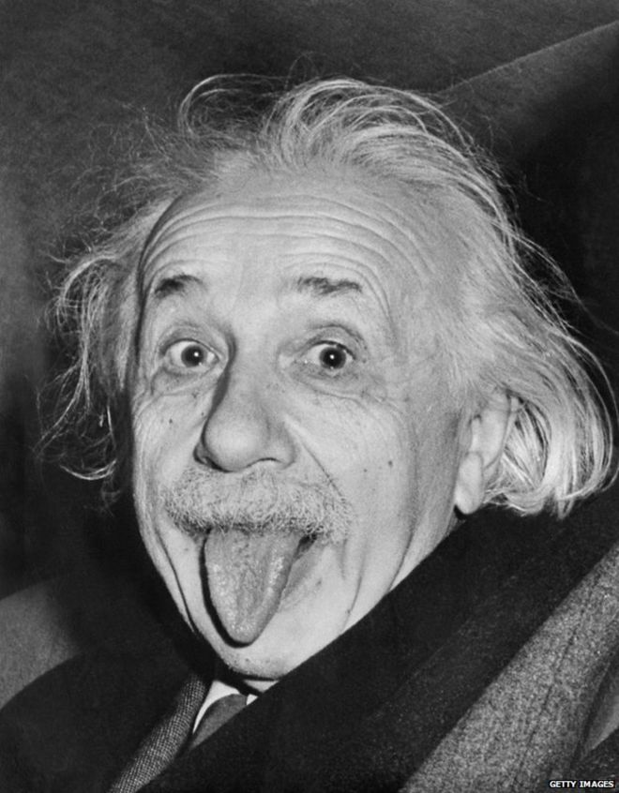
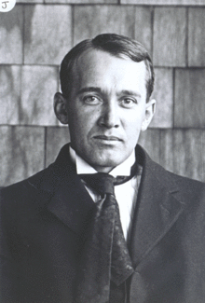
Albert Einstein
Vesto Slipher
Found that mass distorts space time
Found that the universe is always expanding

Slide 15
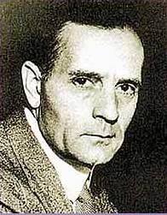
Edwin Hubble
Discovered that there are billions of other galaxies
Found the Andromeda galaxy
The further away a galaxy is, the faster it moves away from others
Dark energy causes the universe to expand

Slide 16
Common Misconceptions related to Gravity
-Space Shuttle astronauts are weightless because there is no gravity outside the atmosphere
Astronauts are not actually weightless, they just feel that way because they are in perpetual freefall. The only force acting on astronauts is gravity, and since you need other oppressing forces to feel gravity, you would therefore feel weightless.
-Gravity is stronger on heavier objects
Gravity acts on all things equally, it’s just air resistance that prevents lighter things from falling as fast.
-There is no gravity on the Moon because it is so far away from the Earth
There is gravity on the moon regardless of where it is because it is being pulled into orbit by the Earth, therefore it has to have gravity. Also, it wouldn’t be a sphere if it didn’t have gravity.

Slide 17
Common Misconceptions related to Gravity
-Gravity is related to magnetic fields and movement.
Neither magnetic fields nor movement have an effect on gravity. Gravity is an individual force that is only affected by mass and distance.
-Planets that are farther away from the Sun have a smaller gravity.
Each planet has a different gravitational force and are independent of each other, however they do have a gravitational pull towards each other but is extremely miniscule
-There is no gravity in space.
There is always gravity in space, even if it doesn’t feel strong, because it is the force that keeps planets in orbit and galaxies constantly moving.

Slide 18
Kahoot
https://play.kahoot.it/#/lobby?quizId=f26ae784-fab4-425f-a22c-b1c0aaec62cc

