Slide 1
Electrostatics
By: Ayla Nappi, Riley Fisher, Jaden Milbrodt, Ben Christensen, and Justin Zoltzman

Slide 2
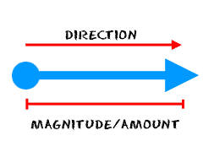
Electrostatic Force
Vector
Direction and Size
Non Contact Force
Notes:
Direction - is determined by charge, the direction will change if it’s being repelled by a like force, or attracted by opposite forces.
Size - Coulomb’s law which we will explain later

Slide 3
Electrostatic Force
Newton’s Third Law: For every action there is an equal and opposite reaction.
Notes:
A force is a mutual reaction that results in equal and opposite push or pull on the objects.

Slide 4
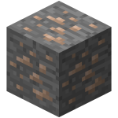
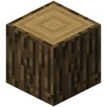
Key words
Conductors - a piece of material that transmits heat, electricity or sound
Ex: metal, iron
Insulators - doesn’t allow the passage of electricity, heat, or sound
Ex: plastic, wood
Electric Current - flow of electric charge
Voltage - amount of energy supplied per charge (measured in volts - V)

Slide 5
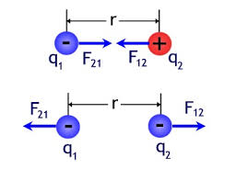
F_{E} = (q₁+q₂)/(r²)
Coulomb’s Law describes interaction between electrically charged objects.
Electrostatic Force and Inverse Square Law
Notes:
Q = charge of each object
R = distance between two objects

Slide 6
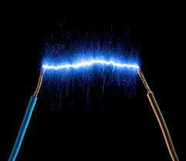
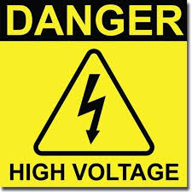
I∝V
I =electric current is a flow of electric charge.
V = voltage (difference)

Slide 7
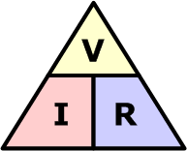
V=IR
Ohm’s Law
V= this is the voltage that is measured across the conductors in units of volts.
I= I is the current through the conductors in units of amperes.
R= R is the resistance of the conductors in the units of Ohms. Although Ohm's law states that the R in this relation is constant, without the current.

Slide 8
R ∝L/A
High resistance → low electric current
R = electric resistance of an electrical conductor, and is measured in the scale of the difficulty to pass an electric current through that conductor.
L = length is the measurement of something from end to end.
A = cross-sectional area is the shape you get when you cut straight through an object.

Slide 9
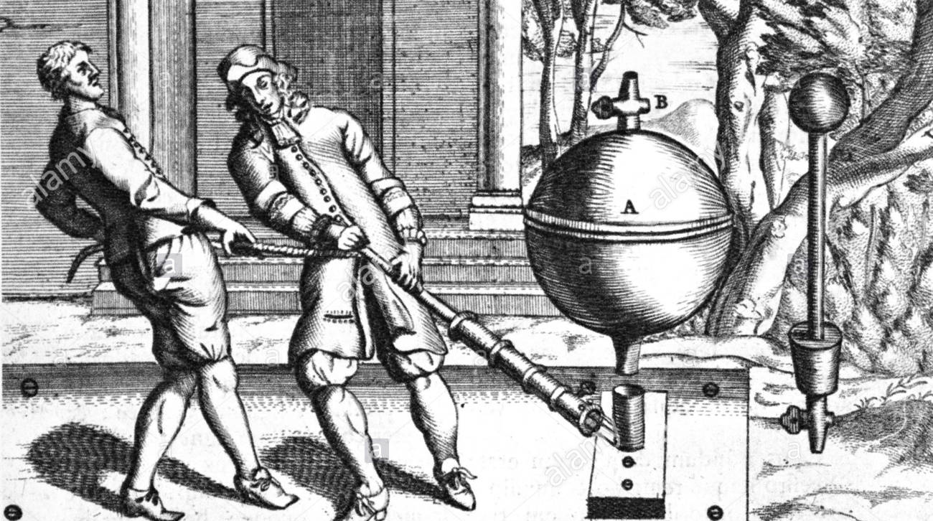
Electrostatic Induction
Von Guerick:
Electrics display electrostatic repulsion as well as attraction.
A substance brought near an electrified sulfur exhibited “temporary electrification”
Notes:
Experiment in which he used sulfur
William Gilbert had already discovered that a number of gems (diamond, sapphire, amethyst, opal, and even ordinary rock crystals) and other metal could be electrified
In the experiment, he built a large sphere, cranked it and was able to use friction to create a temporary electrification

Slide 10
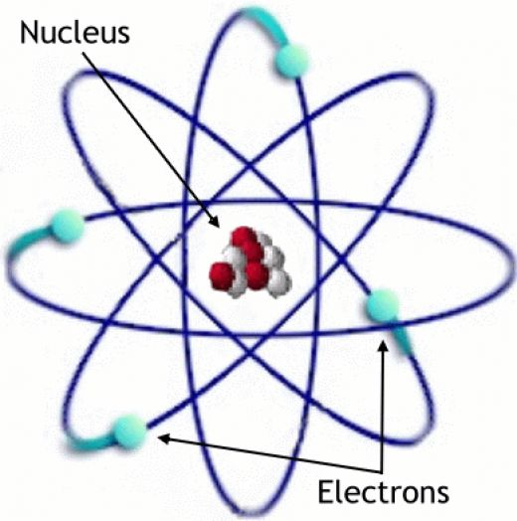
Electron
These electrons (subatomic particles), which are pulled from the atoms of the material, make up electricity
Electrons will always have the same mass and charge, regardless of the size, object, etc.
Negative charge
Notes:
Discoveries of electricity, but it wasn’t until 1897 that the electron itself was discovered

Slide 11
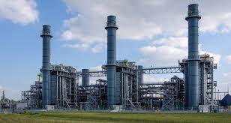
Misconceptions
When you turn on the lights electricity is created.
Zero electrons are sent from the power plant to your house, they only move the electrons which induces an electric current.
It is like a fluid
Notes:
Remember to give the water pump analogy

Slide 12
Misconceptions
The electric current is dependent only on the type of material
Fluid
Size

Slide 13
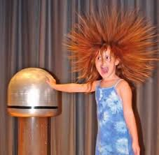
Misconceptions
Electricity can be funneled to one part of an object.
Electron transfer
Electrically charged sphere
Her hair sticks up because the electrons are dispersed and they repel each other.

Slide 14
Misconceptions
Electric current is NOT the same as voltage
Electric current measures the flow of electric charge
Voltage measures the potential energy of an electric field

Slide 15
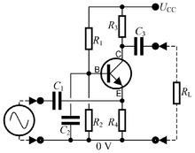
Misconceptions
Conventional Current is not the same as actual current.
Conventional Current flows from positive to negative rather than negative to positive.

Slide 16
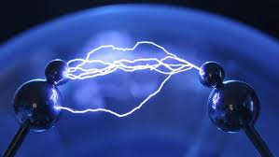
Misconceptions
Electric potential energy is not the same as electric potential. Electric potential energy is the energy associated between two charges while electric potential is the potential energy for one charge.

Slide 17
Question 1
In a closed loop if the voltage is doubled than the current is ______.
Tripled
Halved
Quadrupled
Doubled

Slide 18
Question 1 Answer
In a closed loop if the voltage is doubled than the current is ______.
Tripled
Halved
Quadrupled
Doubled

Slide 19
Question 2
Which force can both attract and repel?
Gravitational
Electrical
Both gravitational and electrical
Neither gravitational or electrical

Slide 20
Question 2 Answer
Which force can both attract and repel?
Gravitational
Electrical
Both gravitational and electrical
Neither gravitational or electrical

Slide 21
Question 3
If a closed loop is 100 cm long and has a cross section area of 0.25 m², how much is the resistance?
75
4
8
16

Slide 22
Question 3 Answer
If a closed loop is 100 cm long and has a cross section area of 0.25 m², how much is the resistance?
75
4
8
16

Slide 23
Question 4
If you were to put a positive charge near a negative charge, what would they do?
Attract
Repel
Connect together
Nothing

Slide 24
Question 4 Answer
If you were to put a positive charge near a negative charge, what would they do?
Attract
Repel
Connect together
Nothing

Slide 25
Question 5
If you were to put two like charges next to each other what would they do?
Attract
Repel
Spontaneously combust
Nothing, they will have no effect.
Generate a magnetic field

Slide 26
Question 5 Answer
If you were to put two like charges next to each other what would they do?
Attract
Repel
Spontaneously combust
Nothing, they will have no effect.
Generate a magnetic field

