Slide 1
Electrostatics
By: Annabelle Dunbar, Daniel Park, Jason Carr, Rosie Ewoldsen, Jonah Garland, and Maddy Tea

Slide 2
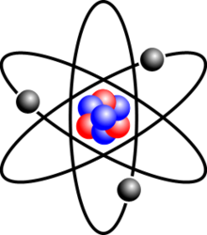
Have you ever walked along a carpet and been shocked after you touch something?
This is due to static electricity. Static electricity is one of many types of electricity and is the growth of electric charge on the exterior of an object.
Examples of static electricity are:
Hair rubbing up against a balloon
Clothes moving around in a dryer

Slide 3
As we know, opposites attract and because of this it can cause two items to attach if they have certain charges.
When a balloon comes in contact with your hair, it attracts. This is because the surface of your hair is giving off a positive charge, while the balloon is giving a negative charge. So by now you should know what's going to happen…. THEY ATTRACT! When the positive and negative charges come in contact, they will attract, which cause the hair on your head to attach to the balloon.

Slide 4
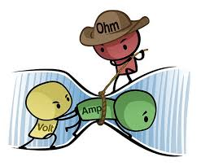
Formulas
V = IR
Voltage is equal to the product of current and resistance
R ∝ L/A
The electrical resistance of a material is proportional to the length and inversely proportional to the cross-sectional area of the material that the current must pass through
Notes:
V stands for Voltage
I stands for current
R stands for resistance
L stands for the length of the material
A is the area of the material
Here is a cartoon representation of Ohm’s Law

Slide 5
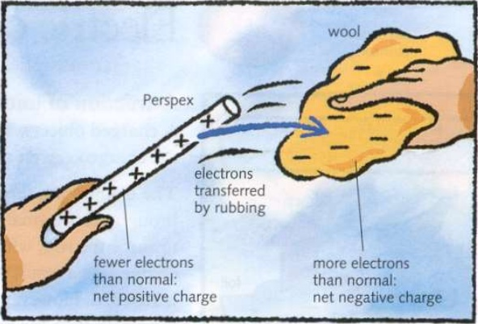
Formulas (continued)
B ∝ I/R
The magnetic force is proportional to the current and inversely proportional to the distance
F_{e} = kq₁q₂/d²
The electrostatic force is proportional to the product of the charges and inversely proportional to the distance squared
Notes:
B is the magnetic force
I is the current
R is the distance
F_{e} is the electrostatic force
K is the
Q is the charge
D is the distance

Slide 6
The Fundamental Laws of Electrostatics
The electric field leaving a volume is proportional to the charge inside
There are no magnetic monopoles
The voltage induced in a closed loop is proportional to the rate of charge of the magnetic field
The magnetic field induced around a closed loop is proportional to the electric current plus the rate of change of the electric field
Notes:
The electric field leaving a volume is proportional to the charge inside
This means that every magnet has two poles
The voltage induced in a closed loop is proportional to the rate of charge of the magnetic field
The magnetic field induced around a closed loop is proportional to the electric current plus the rate of change of the electric field

Slide 7
Basic Vocabulary:
Charges - similar to what mass is to gravity; an attribute that protons and electrons have (positive or negative)
Conductors - materials that allow for electricity to flow through them easily
Insulators - materials that resist the flow of electricity
Voltage - electric potential or potential difference expressed in volts
Electric current - the flow of electric charges
Magnetic domain - the clusters of aligned atoms
Lenz’s Law - an induced voltage always gives rise to a current whose magnetic field opposes the original magnetic field that produces it.

Slide 8
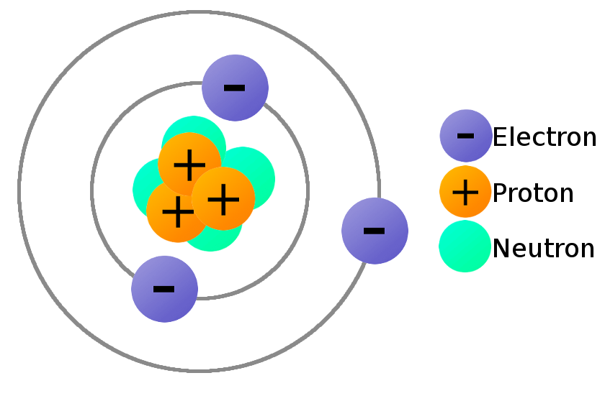
Charge of Atoms
Electrons always have a negative charge.
Protons always have a positive charge.
Neutrons always have no charge.

Slide 9
Charge Conservation
A charge is never created nor destroyed, only transferred from object to object.
If an object has more negative charge than positive charge, it is considered to be negatively charge.
If an object has more positive charge than negative charge, it is considered to be positively charged.
If an object has equal amounts of positive and negative charge, it is considered to be neutral.

Slide 10
IMPORTANT:
A MAGNETIC FIELD is produced by the MOTION of ELECTRIC CHARGE!
An ELECTRIC FIELD is produced by a CHANGING MAGNETIC FIELD!

Slide 11
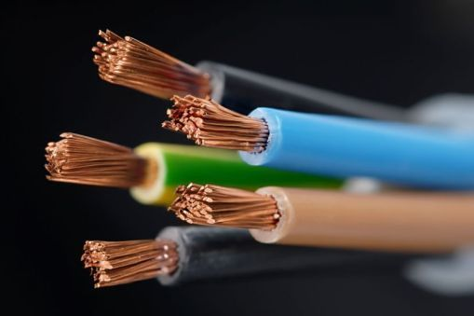
Electric Conductors V.S. Insulators
Conductors allow for the passage of electricity readily.
Insulators resist or dampen the passage of electricity.

Slide 12
Inductive Charge
What does it mean? generating a magnetic field by adjusting the magnetic flux
How does it work? uses an electromagnetic field to transfer energy between two objects through electromagnetic induction
Examples: - Drone, Phone, Electric ToothBrush, wireless headphones, wireless charging, etc.
Notes:
Magnetic flux is the calculation of the complete magnetic field when it passes through a designated area

Slide 13
Lightning
Negative charges gather in the bottom of the cloud, forcing the negative charges in the ground to retreat, leaving the ground positive. Now that the ground is positive and the bottom of the cloud is negative, the cloud repels the negative charges and they attract towards the ground. The positive charges from the ground attract up towards the sky and the negative charges. When they meet they create a conductive bridge that allows for electrons to jump to the ground. The fast moving electrons excite the air around the bridge that it emits light, creating lightning. *The charges that make up the cloud and the ground do not move. Even the positive charges that were launched up were only that way because the electrons has left, not because the positive charges had moved*

Slide 14
Important Facts from the Discovery of Electrons
Subatomic particles (electrons) from the atoms of the material make up electricity
All electrons are exactly the same
Electrons are negatively charged

Slide 15
Common Misconceptions
Lightning rods discharge the clouds.
“Static Electricity” is caused by friction.
Humid air is conductive.
Batteries store charge.
“Electrostatics” is the study of electricity at rest.
Clouds are charged by rubbing together.

Slide 16
Kahoot!
Electrostatics

Slide 17
The End

