Slide 1
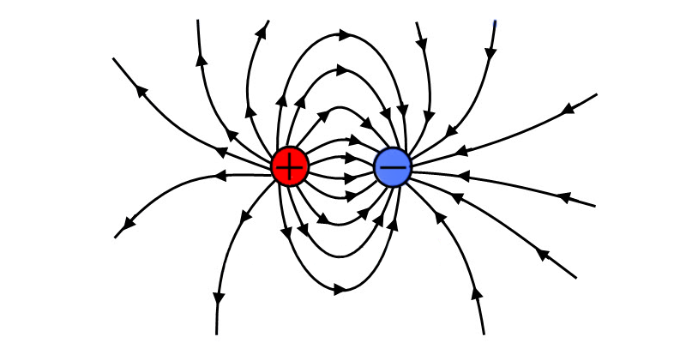
Electrostatics
By: Sophie Clarkson, Jessie Lee, Emily Strauss, Isabella Caramaschi, Kobi Hinzer, and Natalie Yu

Slide 2
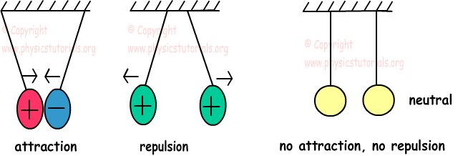
What are Signs of Electricity’s First Appearance?
When the ancient Greeks rubbed an amber rod with a piece of cloth, the amber began to attract small pieces of leaves or dust. The Greeks named this phenomenon electricity, which came from the greek word elektron, which means amber.

Slide 3
Equations
Electrostatic Force and Inverse Square Law F_{e} ∝ q₁q₂/r²
The electrostatic force is proportional to the product of the charges & inversely proportional to the distance squared.
Relationship between Current and Voltage I ∝ V
The electric current flowing through an object is to proportional the voltage difference across that object

Slide 4
Equations (continued)
Ohm’s Law V = IR
Voltage is equal to the product of current and resistance
Resistance R ∝ L/A
The electrical resistance of a material is proportional to the length and inversely proportional to the cross-sectional area of the material that the current must pass through

Slide 5
Equations (continued)
Coulomb’s Law F_{E} = (kQ₁Q₂)/d²
Electrostatic force is equal to the product of the charges and the constant of electricity divided by the distance squared.
Constant of Electricity k = 9*10⁹

Slide 6
Scientists who contributed to Electricity
William Gilbert (1544-1603) - Found some substances that can be electrified easily and found some that can’t
Otto von Guericke (1602-1686) - Created a sphere with sulfur so that electricity can be cheap; Discovered temporary electrification
Stephan Grey (1666-1736) - Discovered that electricity spread through some materials
Charles Francois Du fay (1698 - 1739) - Two types of electric fluid called “vitreous electricity” and “resinous electricity”.
Benjamin Franklin (1706 - 1790) - He concluded that there are positive and negative charges. Charge cannot be created or destroyed.
Charles-Augustin de Coulomb (1736-1806) - Demonstrated that electrostatic force followed the inverse square law

Slide 7
Scientists who contributed to Electricity (Continued)
Luigi Galvani (1737-1798) - Discovered that only needed simultaneous contact with a muscle and two dissimilar metals to make muscles twitch; source of electricity is “animal electricity”
Alessandro Volta (1745-1827) - Said electric charge originated from metals and not muscle; created the first battery (Crown of Cups)
Michael Faraday (1791-1867) - Discovered connection between electricity and magnetism
Georg Simon Ohm (1789-1854) - Found relationship between voltage in battery and rate of current
Heike Kamerlingh-Onnes (1853-1926) - Discovered superconductivity
J. J. Thomson (1856-1940) - Discovered the electron

Slide 8
Common Misconceptions
Misconception: In the rod/fur experiment, the negatively charged rod transfers positive charges to the positively charged fur cloth.
Truth: The positively charged fur cloth transfers electrons to the negatively charged rod.
Misconception: Circuits only use current electricity, and electrostatics aren’t involved.
Truth: All motors utilize static electricity- the surface charge/voltage powers the electric currents.
Misconception: The size of an electrode affects the voltage that the electrons have in order to pass through a current.
Truth: This would only be true if the electrode was so small that before it had the chance to reach its equilibrium it would be consumed.

Slide 9
Common Misconceptions
Misconception: Static electricity is the same as electricity.
Truth: Static electricity is motionless electricity while flowing electricity moves around freely.
Misconception: All atoms have a charge.
Truth: Atoms that are missing some part of their charge are called Ions.
Misconception: People believe that electrons can flow easily through fluids.
Truth: The flow of a charge is created when there is ion movement. Electrons can flow through wires while ions are capable of flowing through solutions.

Slide 10
Conservation of Charge
-Neutral Atom: balanced, no net charge
-Charged Atom= an ion (positive & negative ions)
-imbalance of electrons and protons w/in an object ---> electrically charged, caused by adding or removing electrons
-electrons >protons, the object is negatively charged
-electrons<protons, the object is positively charged
*SO, electrons are never created or destroyed...they are transferred

Slide 11
Induction/Charge Polarization
Induction:
-electrons are caused to gather or disperse in response to the presence of a nearby charge
Ex: a charged rod held near a metal surface repels charges of the same sign and attracts opposite charges (redistribution of charge on object w/o changes in the net charge)
Charge Polarization:
-the surface near the charged object becomes oppositely charged
Ex: when you stick a charged balloon to a wall

Slide 12
Electrostatic Station LAb
What are the reactions and why/how
Example: The can quiver
Rubbing the rabbit fur against the tube creates a static charge on the tube. This gives the tube a negative charge allowing the tube to be attracted to the positively charged can because the positives from the can attract to the negatively charged stick.
Example 2: Water Polarizations
When taking a balloon and rubbing it against the fur it creates the balloon to have a negative charge. After charging the balloon, turning on the water and placing the balloon close to it will make the water deflect from the balloon because they are oppositely charged so it causes the balloon to deflect the water.
Example 3: Single Balloon
When objects, in this case, the balloon and the wall, rub against each other, static electricity is created. This is because the negatively charged balloon polarized molecules in the wooden wall and creates a positively charged surface so the balloon sticks to the wall. (opposite surface charges)

