Slide 1
Momentum
By: Lauren Lee, Ryan Grande, Avery Romero, Olivia Joung, Ray Roberts, Tyler Scribner

Slide 2
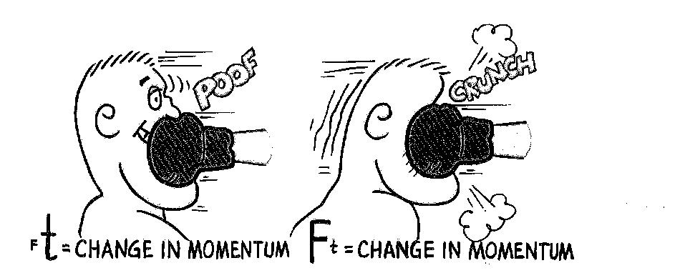
Momentum
Definition - the quantity of motion of an object

Slide 3
Main Equation to know for Momentum
momentum = mass ● velocity
Any type of object’s momentum will always be equal to the products of its mass and velocity

Slide 4
Equation Breakdown
p = m (v)
momentum = mass (velocity)

Slide 5
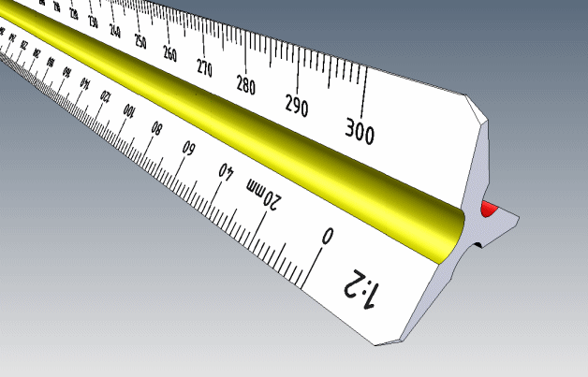
Units of Measurement
Momentum (p)
Mass (m)
Velocity (v)
kg x m/s
kg
m/s

Slide 6
Conservation of Momentum
“The total momentum of an isolated system remains constant.”

Slide 7
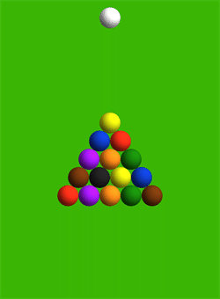
Total Momentum of a System
“Individual momentum might change, but as long as nothing leaves and nothing new enters the system, the total momentum will remain the same.”

Slide 8
Common Misconceptions/Mistakes

Slide 9
Always keep the Law of Conservation of Momentum in mind.
“The total momentum of an isolated system remains constant.”
Momentum is a vector.
Momentum constitutes velocity and the effect of mass
External factors
Consider external factors such as air resistance and wind if applicable

Slide 10
4. Application of Formulas
Even if the object is stationary all the formulas still apply
5. Forces
a. Don’t forget that forces like friction are going to remove mechanical energy
6. Expenditure of Power
a.The Formula P=FV is straightforward, but remember that the object expending the power to make the force doesn’t have to be the object moving at speed v.

Slide 11
Practice
https://play.kahoot.it/#/lobby?quizId=2e6a08a0-7af3-4109-bcd0-ecfa79455b9a

Slide 12
Thanks for watching!

